Slide 1
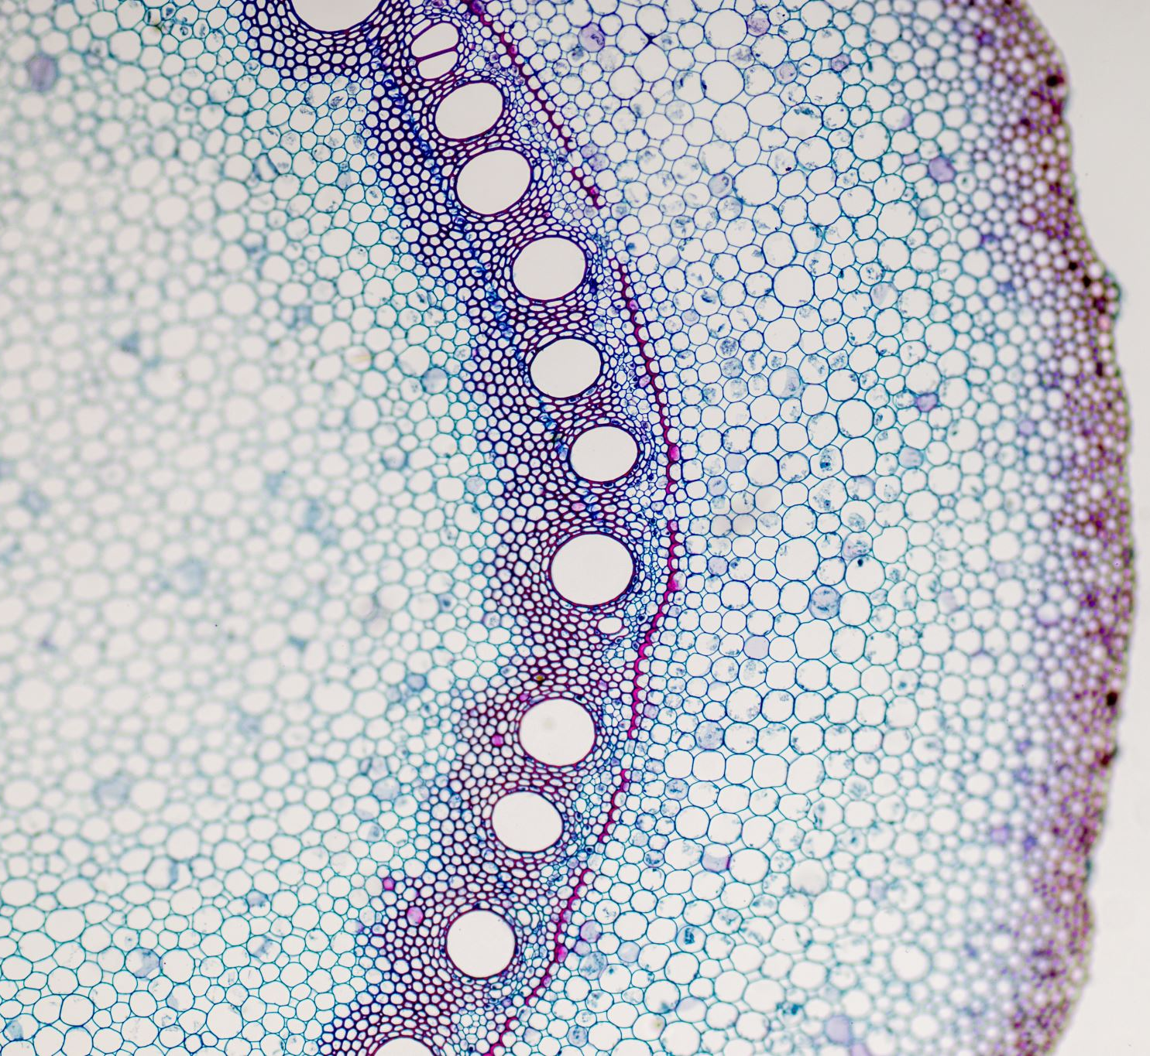
Single Cell Analysis
Class presentation
Rahul

Slide 2

Virus-inclusive single-cell RNA sequencing reveals the
molecular signature of progression to severe dengue
Fabio Zanini^{a,1}, Makeda L. Robinsonb,^{c,1}, Derek Crooteª , Malaya Kumar Sahoo^{d} , Ana Maria Sanz^{e} , Eliana Ortiz-Lasso^{f} , Ludwig Luis Albornozf , Fernando Rosso^{e,g}, Jose G. Montoya^{c} , Leslie Goo^{h} , Benjamin A. Pinsky^{c,d}, Stephen R. Quakea,^{h,i,2}, and Shirit Einavb^{,c,2}
ª Department of Bioengineering, Stanford University, Stanford, CA 94305;
^{b} Department of Microbiology and Immunology, Stanford University School of Medicine, Stanford, CA 94305;
^{c} Division of Infectious Diseases and Geographic Medicine, Department of Medicine, Stanford University School of Medicine, Stanford, CA 94305;
^{d} Department of Pathology, Stanford University School of Medicine, Stanford, CA 94304;
^{e} Clinical Research Center, Fundación Valle del Lili, Cali 760026, Colombia;
^{f} Pathology and Laboratory Department, Fundación Valle del Lili, Cali 760026, Colombia;
^{g} Division of Infectious Diseases, Department of Internal Medicine, Fundación Valle del Lili, Cali 760026, Colombia;
^{h} Chan Zuckerberg Biohub, San Francisco, CA 94158; and ^{i} Department of Applied Physics, Stanford University, Stanford, CA 94305
PNAS December 26, 2018 115 (52) E12363-E12369; first published December 7, 2018; https://doi.org/10.1073/pnas.1813819115

Slide 3
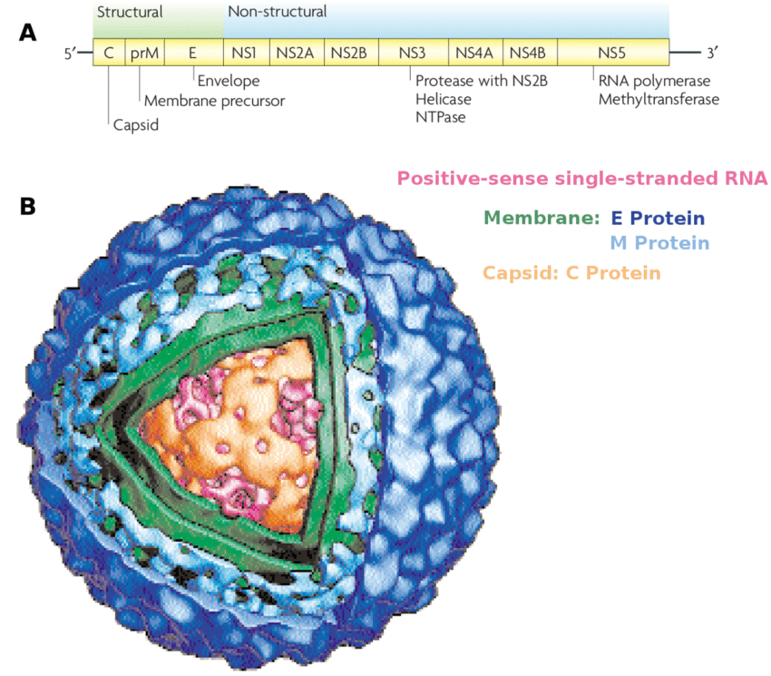
Dengue virus: Structure and Genome
Flavivirus: 2 outer membrane(prM and E protein)
4 serotypes: DENV1 to DENV4
Genome: 10.7 kb single positive stranded RNA.
All serotypes can cause severe and fatal disease.
Most fatal DENV2
Estimated 100-400 million infections each year(WHO).
There is no specific treatment for dengue/severe dengue.
Early detection is important however symptoms
are similar flu like symptoms.
5-20% patients within 4-7 days leads of severe dengue(SD) manifested by bleeding, plasma leakage, shock, organ failure, and death.
https://doi.org/10.2174/0929866525666180709115506

Slide 4
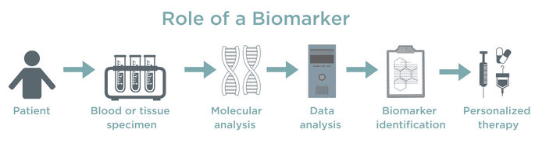
Objective: Biomarkers
Biomarkers for early detection of SD based on molecular features of the patients blood.
~ Early detection save lives.
DEG analysis extracted from blood or peripheral blood mononuclear cells (PBMCs).
Notes:
These efforts have focused on two experimental techniques: (i) flow cytometry of fixed blood cell populations (15), and (ii) gene expression in bulk RNA extracted from blood or peripheral blood mononuclear cells (PBMCs) (16–19). Although useful, these studies suffer from several limitations. The majority of these studies identified genes whose altered expression is associated with, but does not precede, the onset of SD and therefore cannot be used as prognostic biomarkers. From a technical standpoint, while flow cytometry has a high throughput, it is constrained to a few protein markers that are selected a priori, making it excellent for separating known, discrete cell populations but less appropriate for screening the complex, dynamic landscape of cell types, subtypes, and states characteristic of immune responses

Slide 5
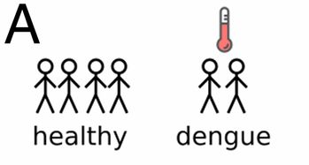
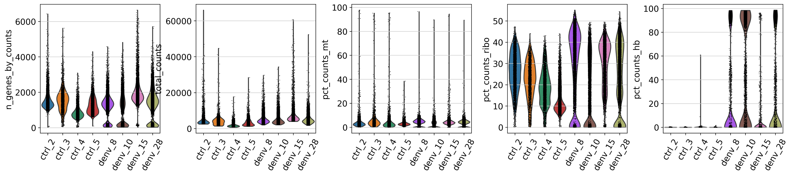
4 sample Ctrl & 4 sample DENV postive
Analysis
Dataset QC

Slide 6
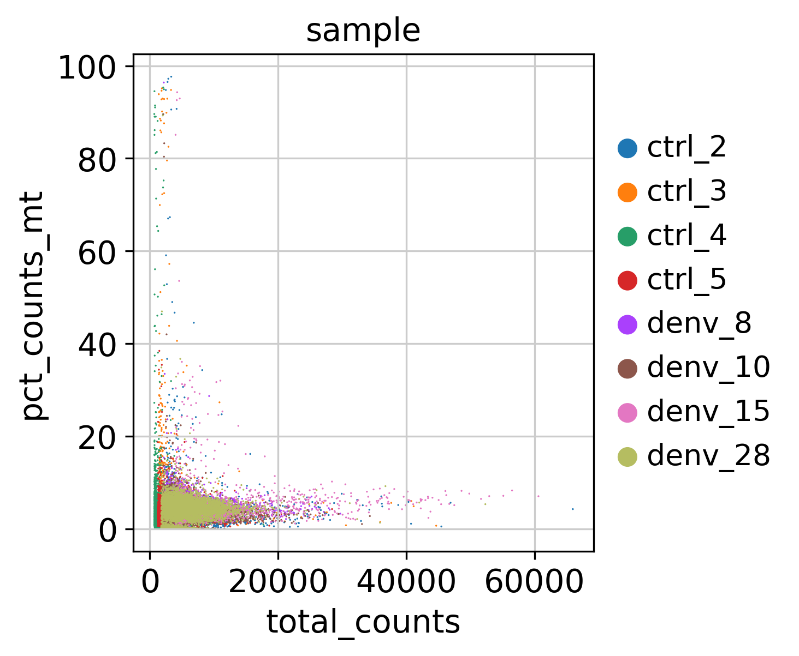
Sample info

Slide 7
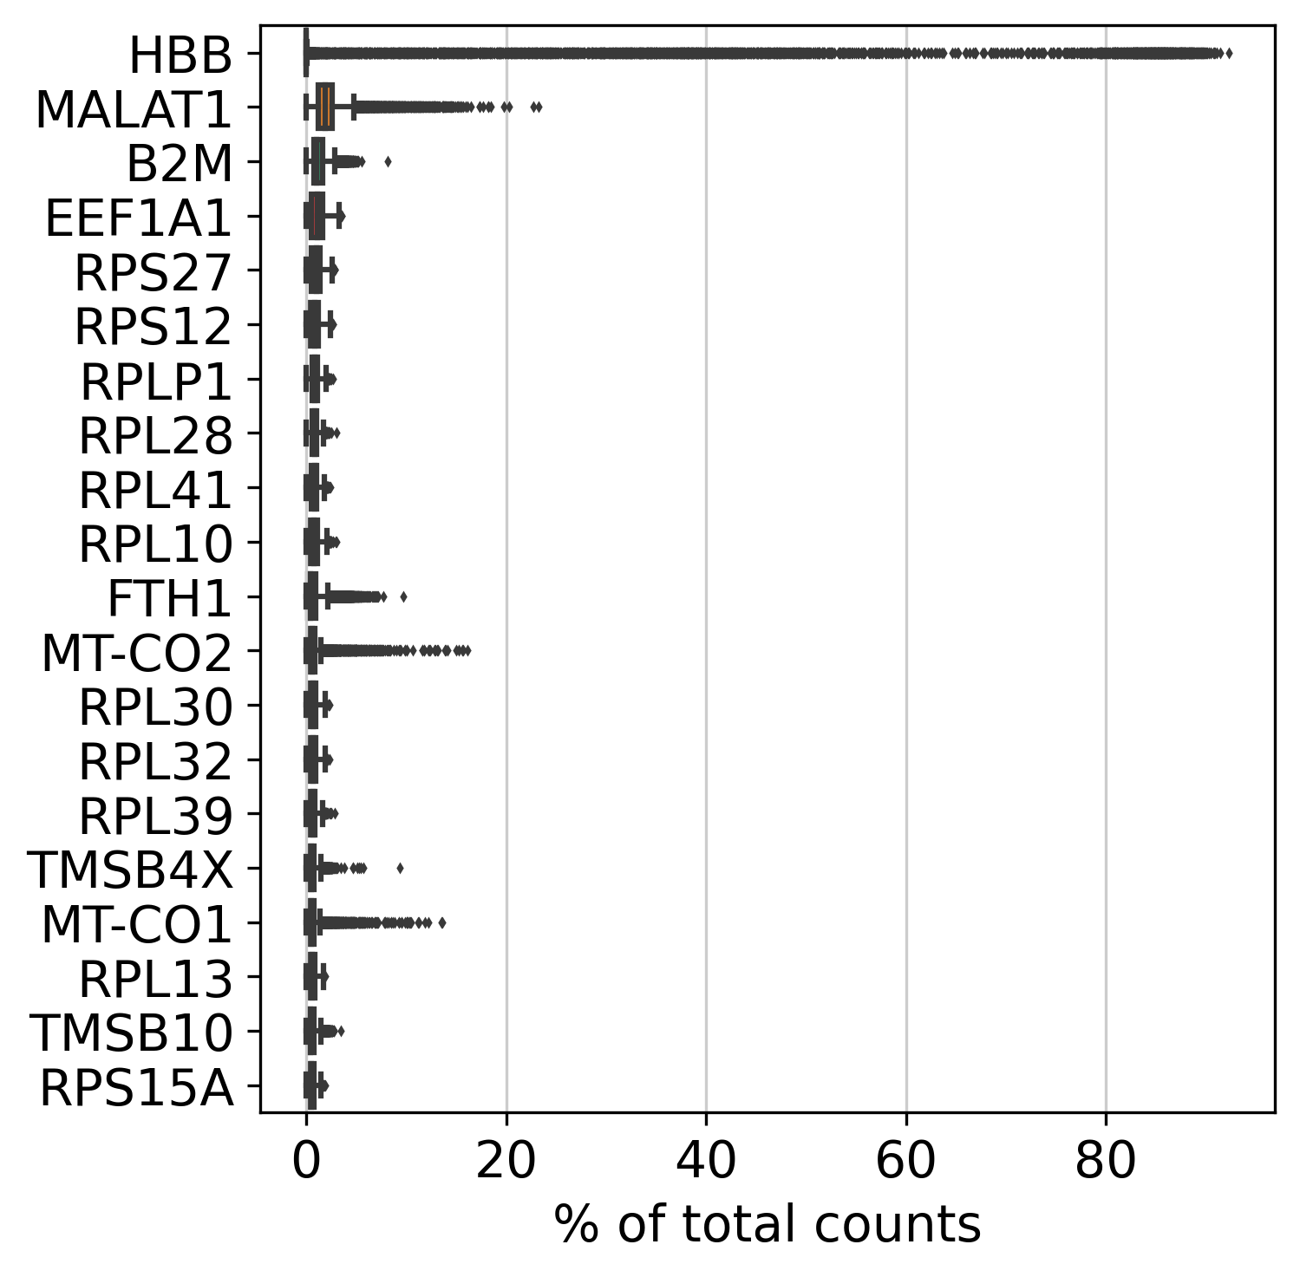
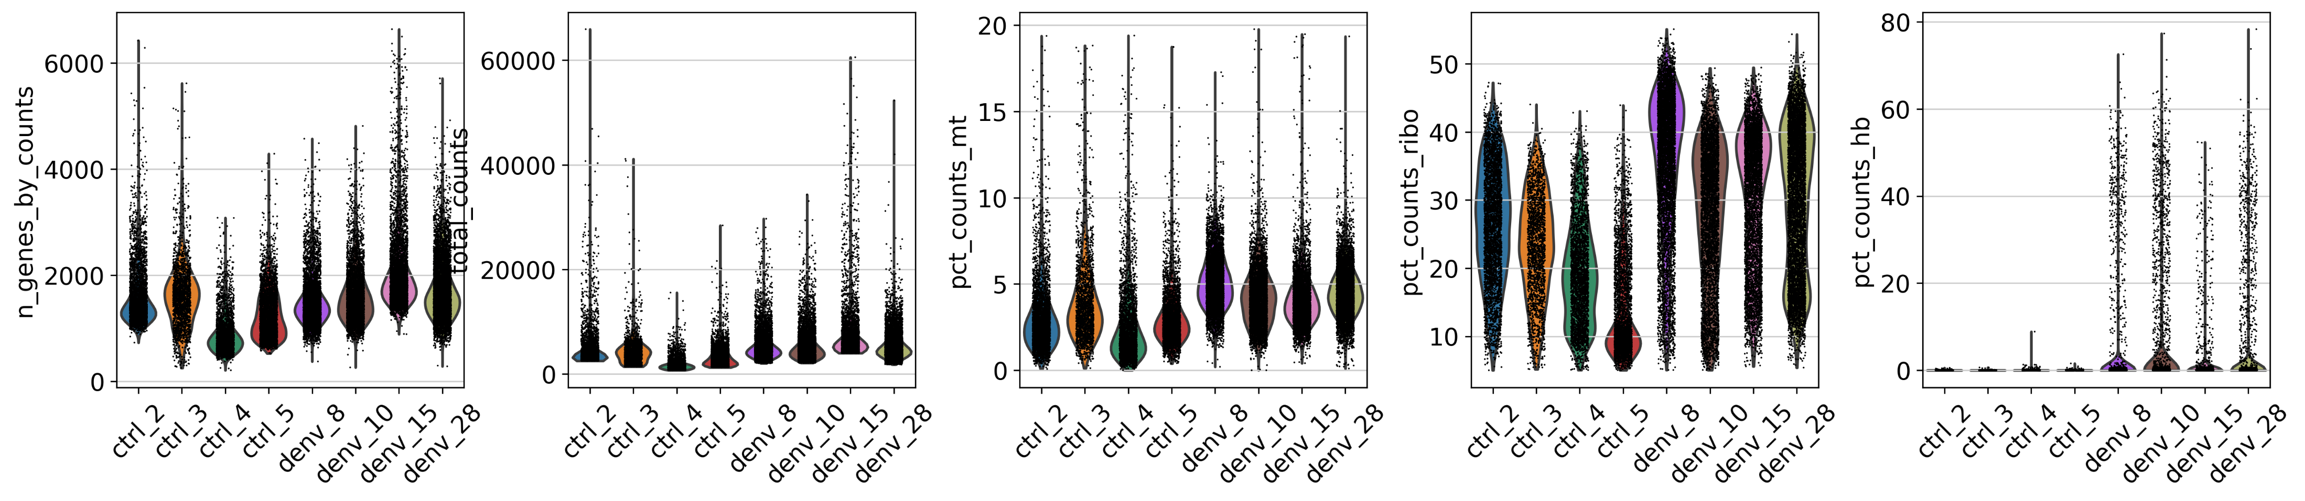
Filtering
filtered out 7858 cells that have less than 200 genes expressed filtered out 11891 genes that are detected in less than 4 cells
Remaining cells 36718

Slide 8
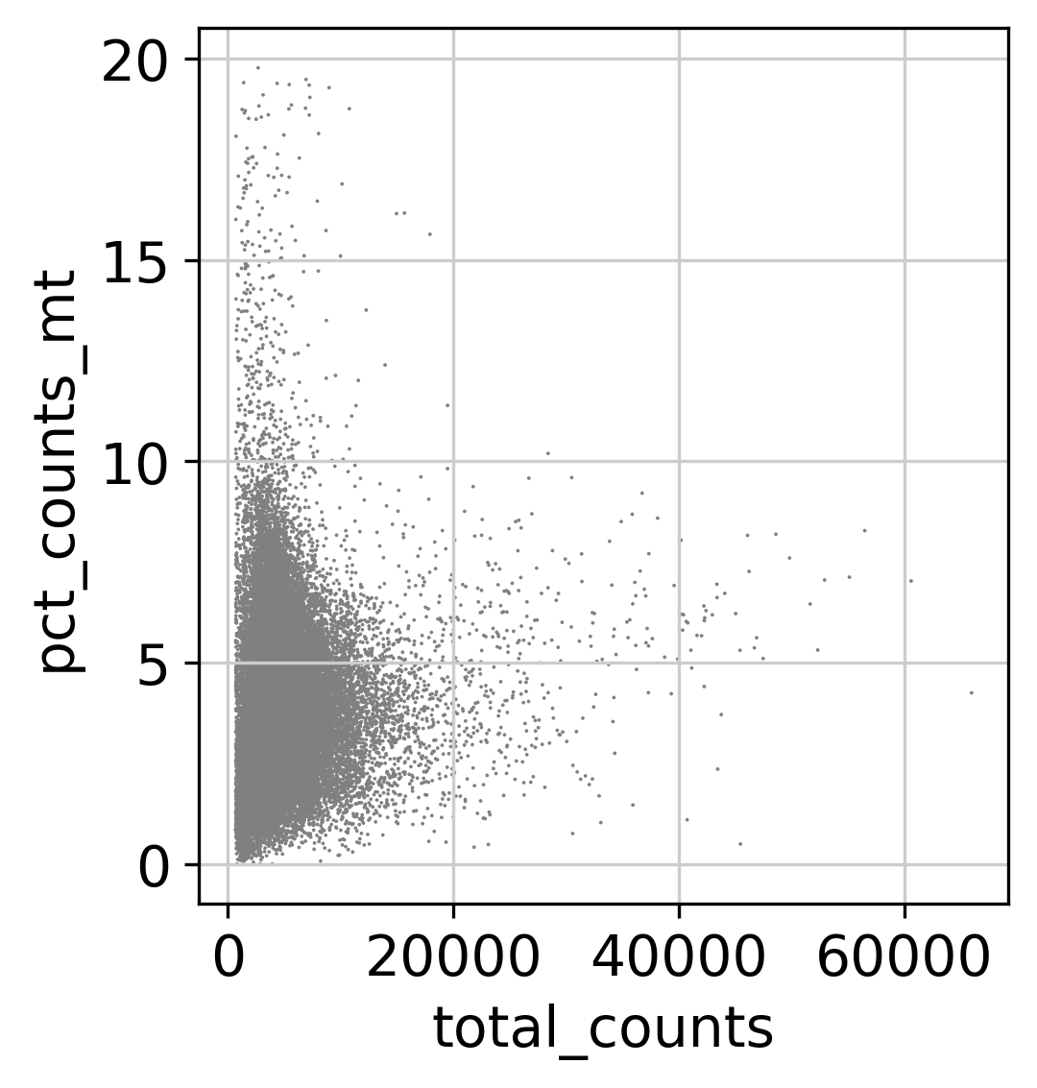
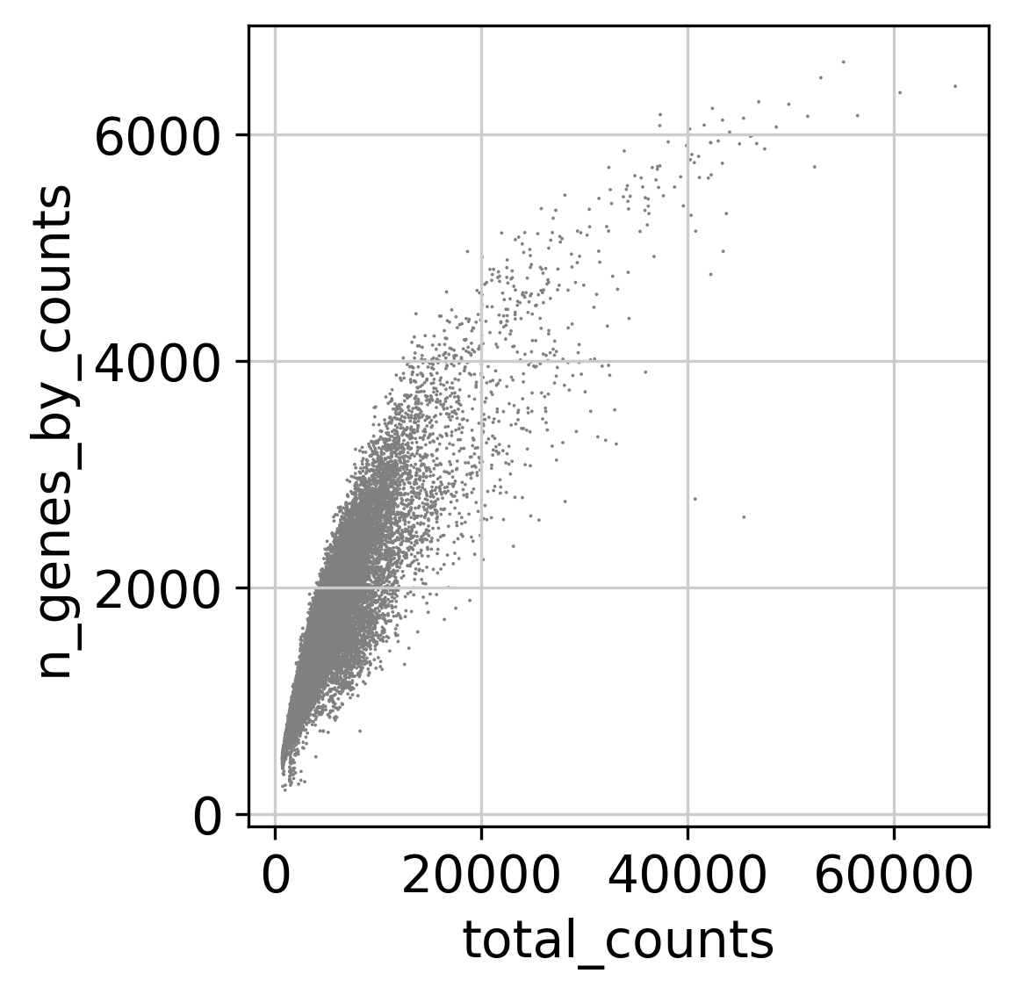

Slide 9
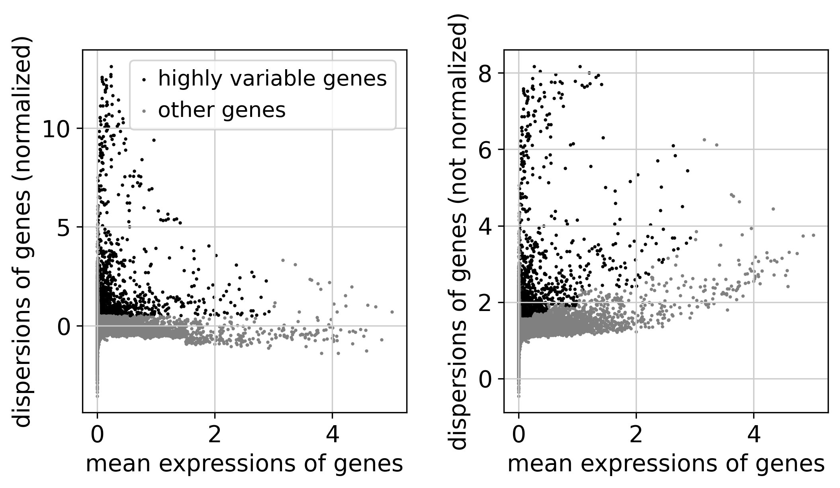
Highly variable genes

Slide 10
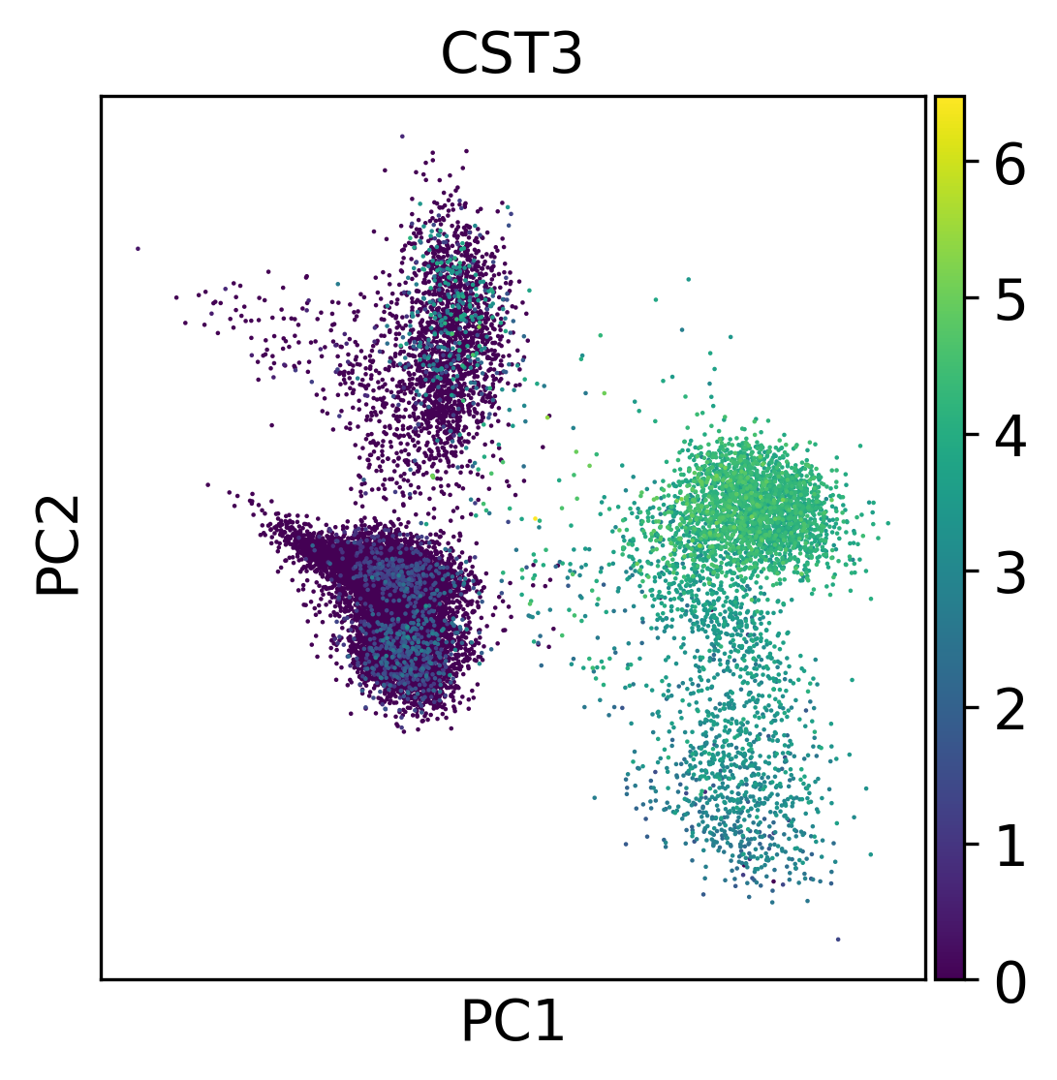
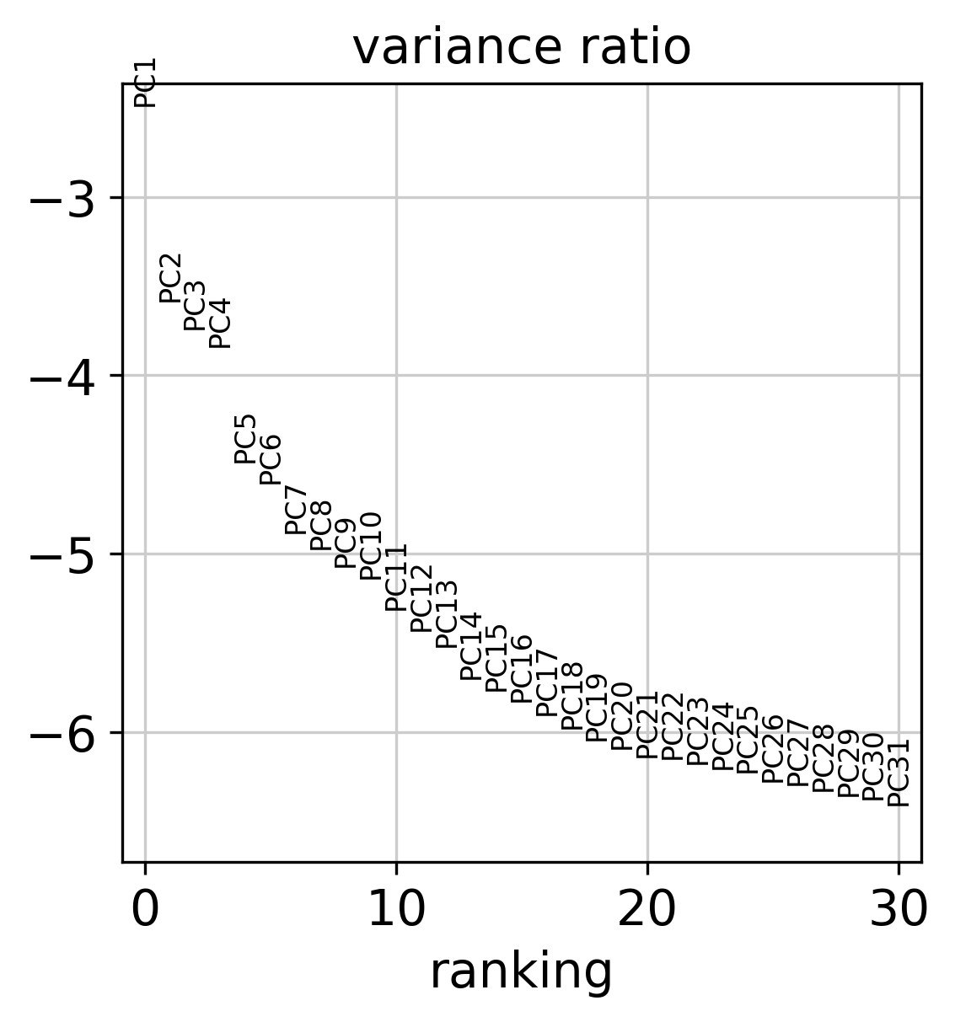
Principal component analysis on highly variable genes

Slide 11
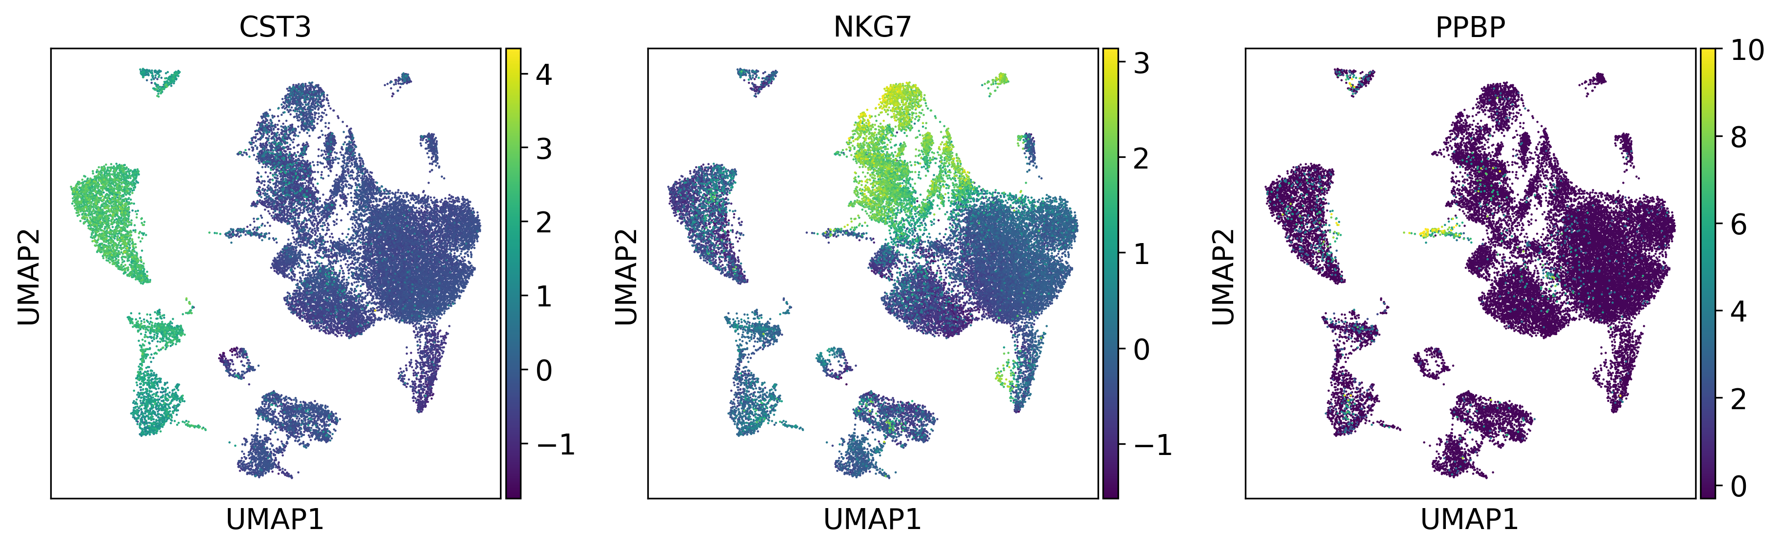
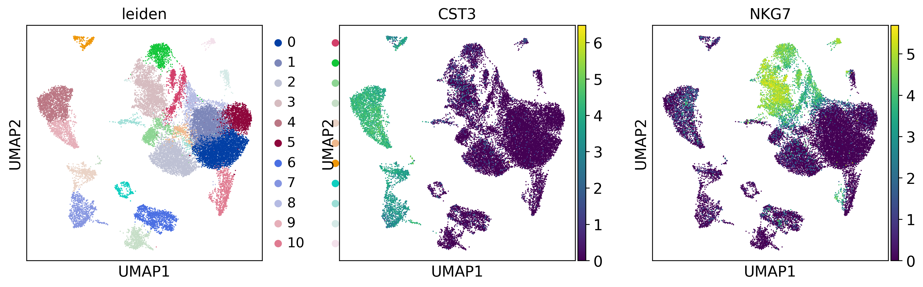
Embedding the neighborhood graph
scaled and corrected gene expression plot
Clustering the neighborhood graph

Slide 12
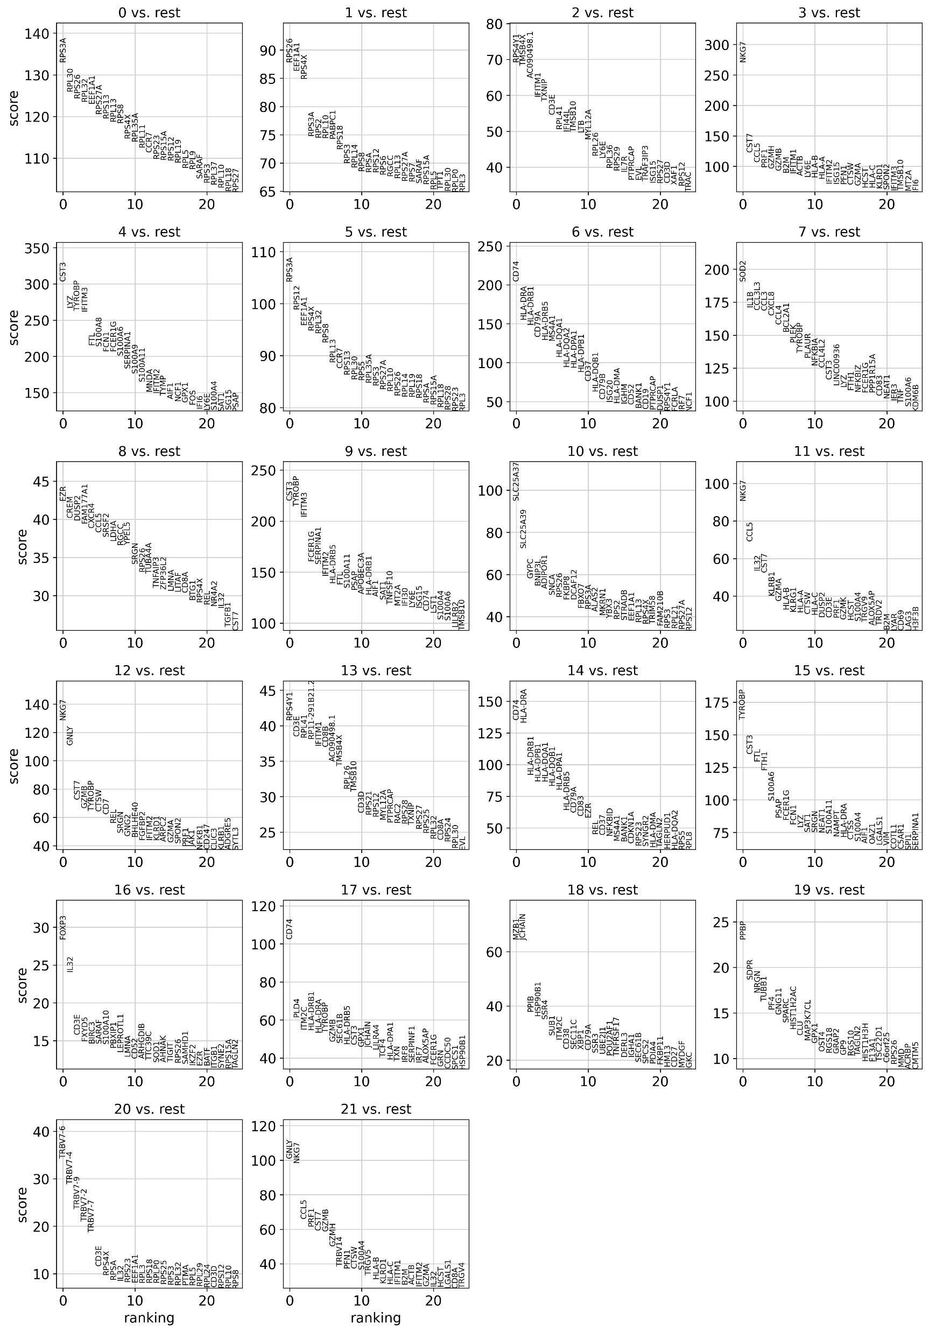
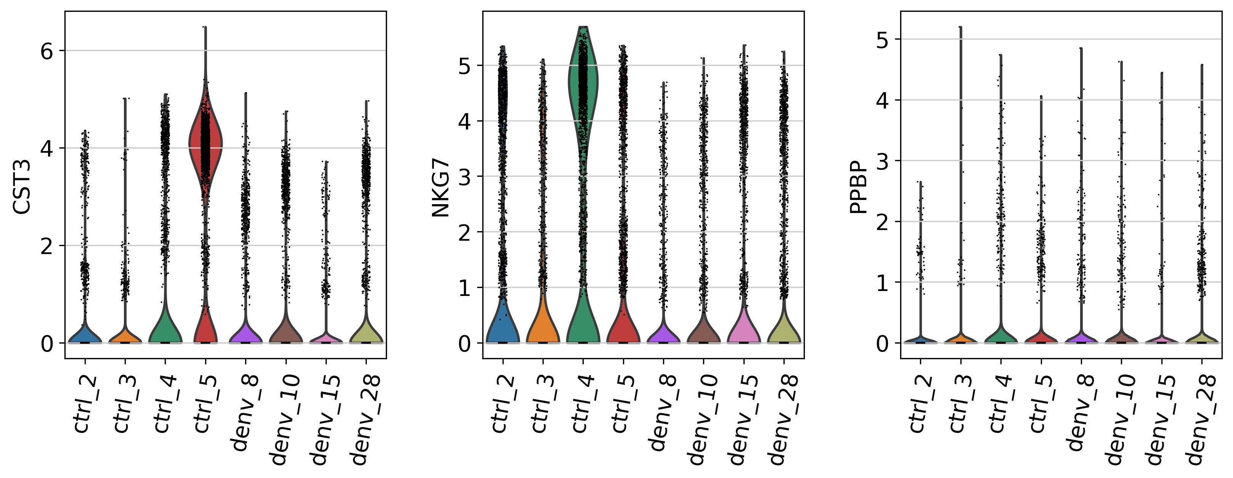
Ranking for the highly differential genes in each cluster
T-test

Slide 13
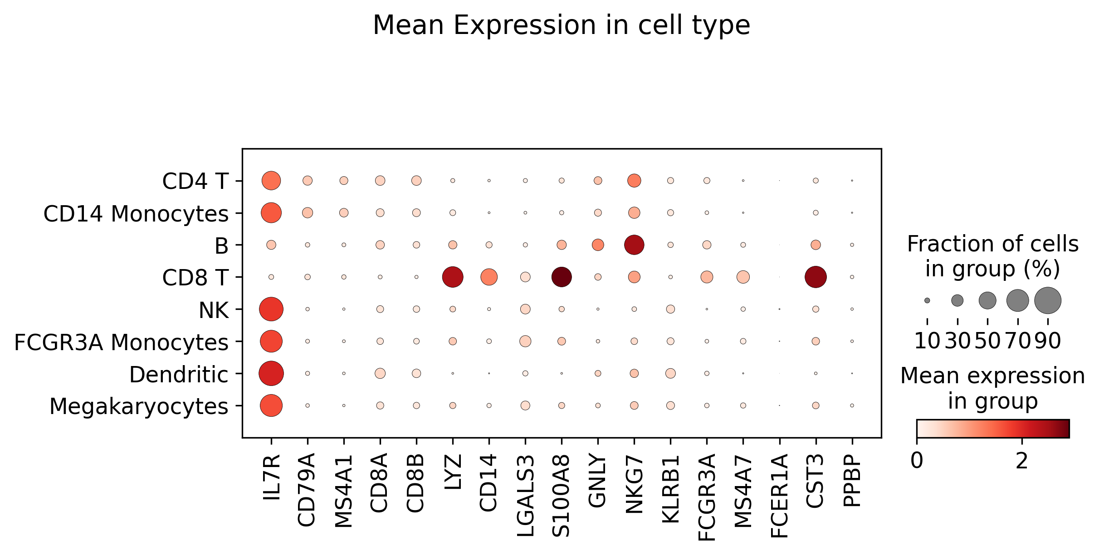
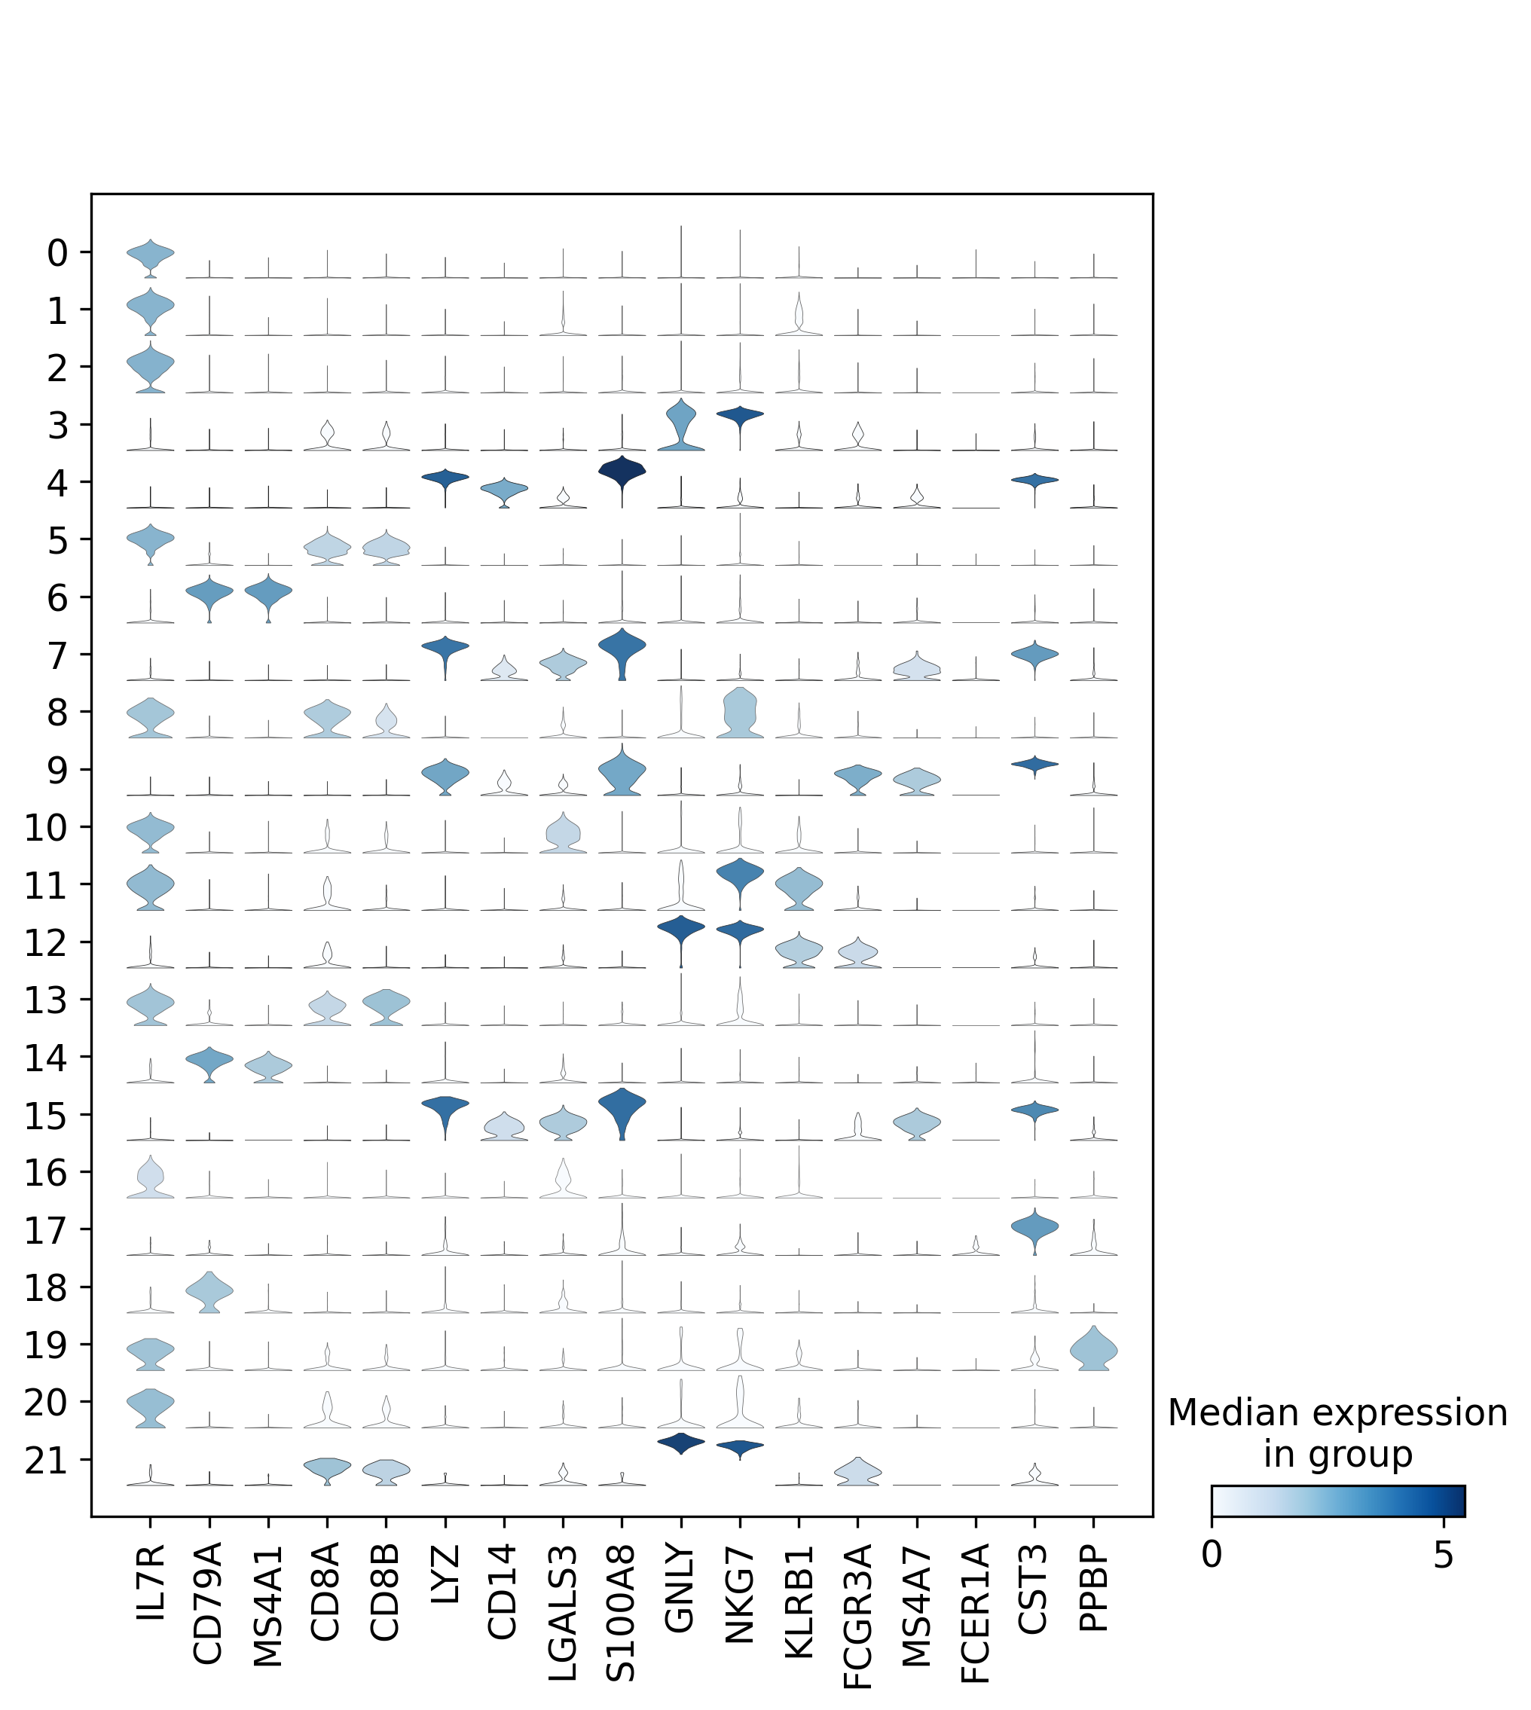
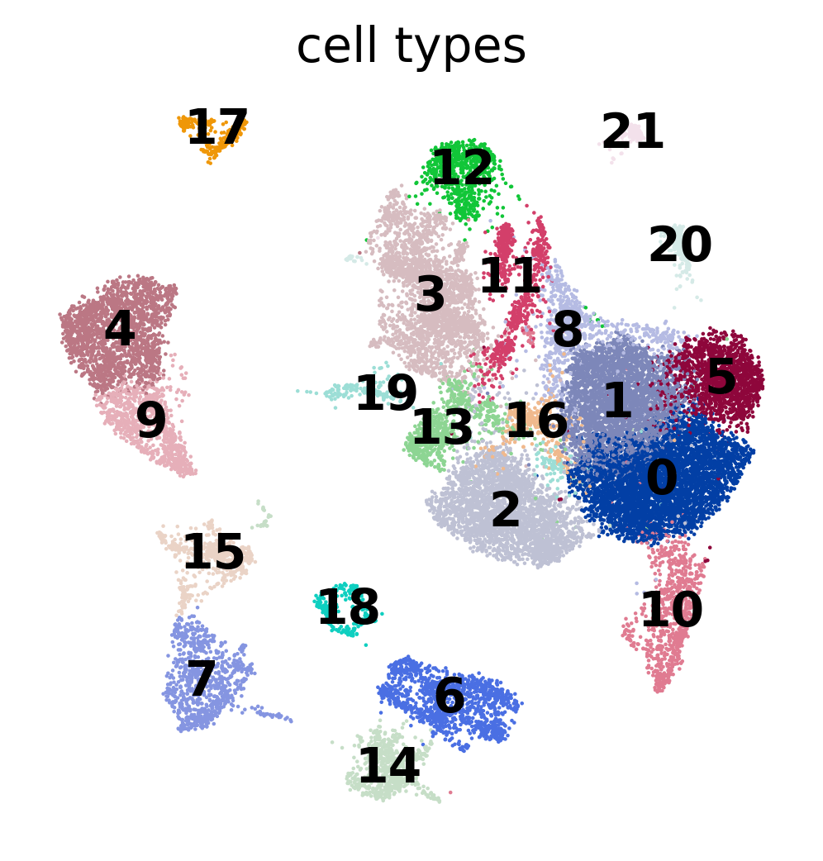
Some gene expression in various cell types and cluster

Slide 14
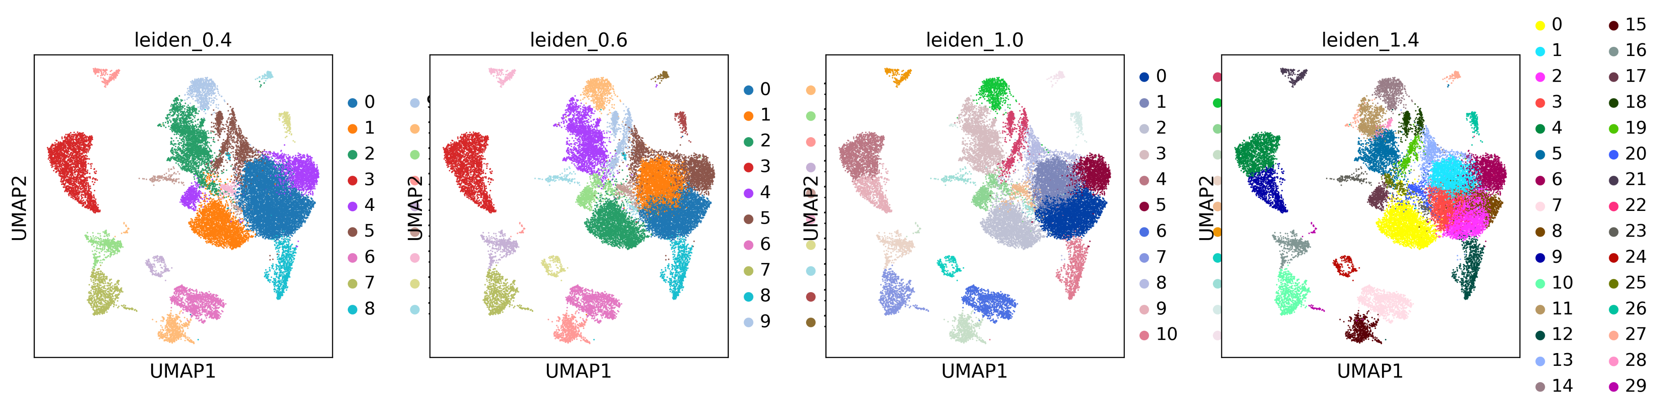
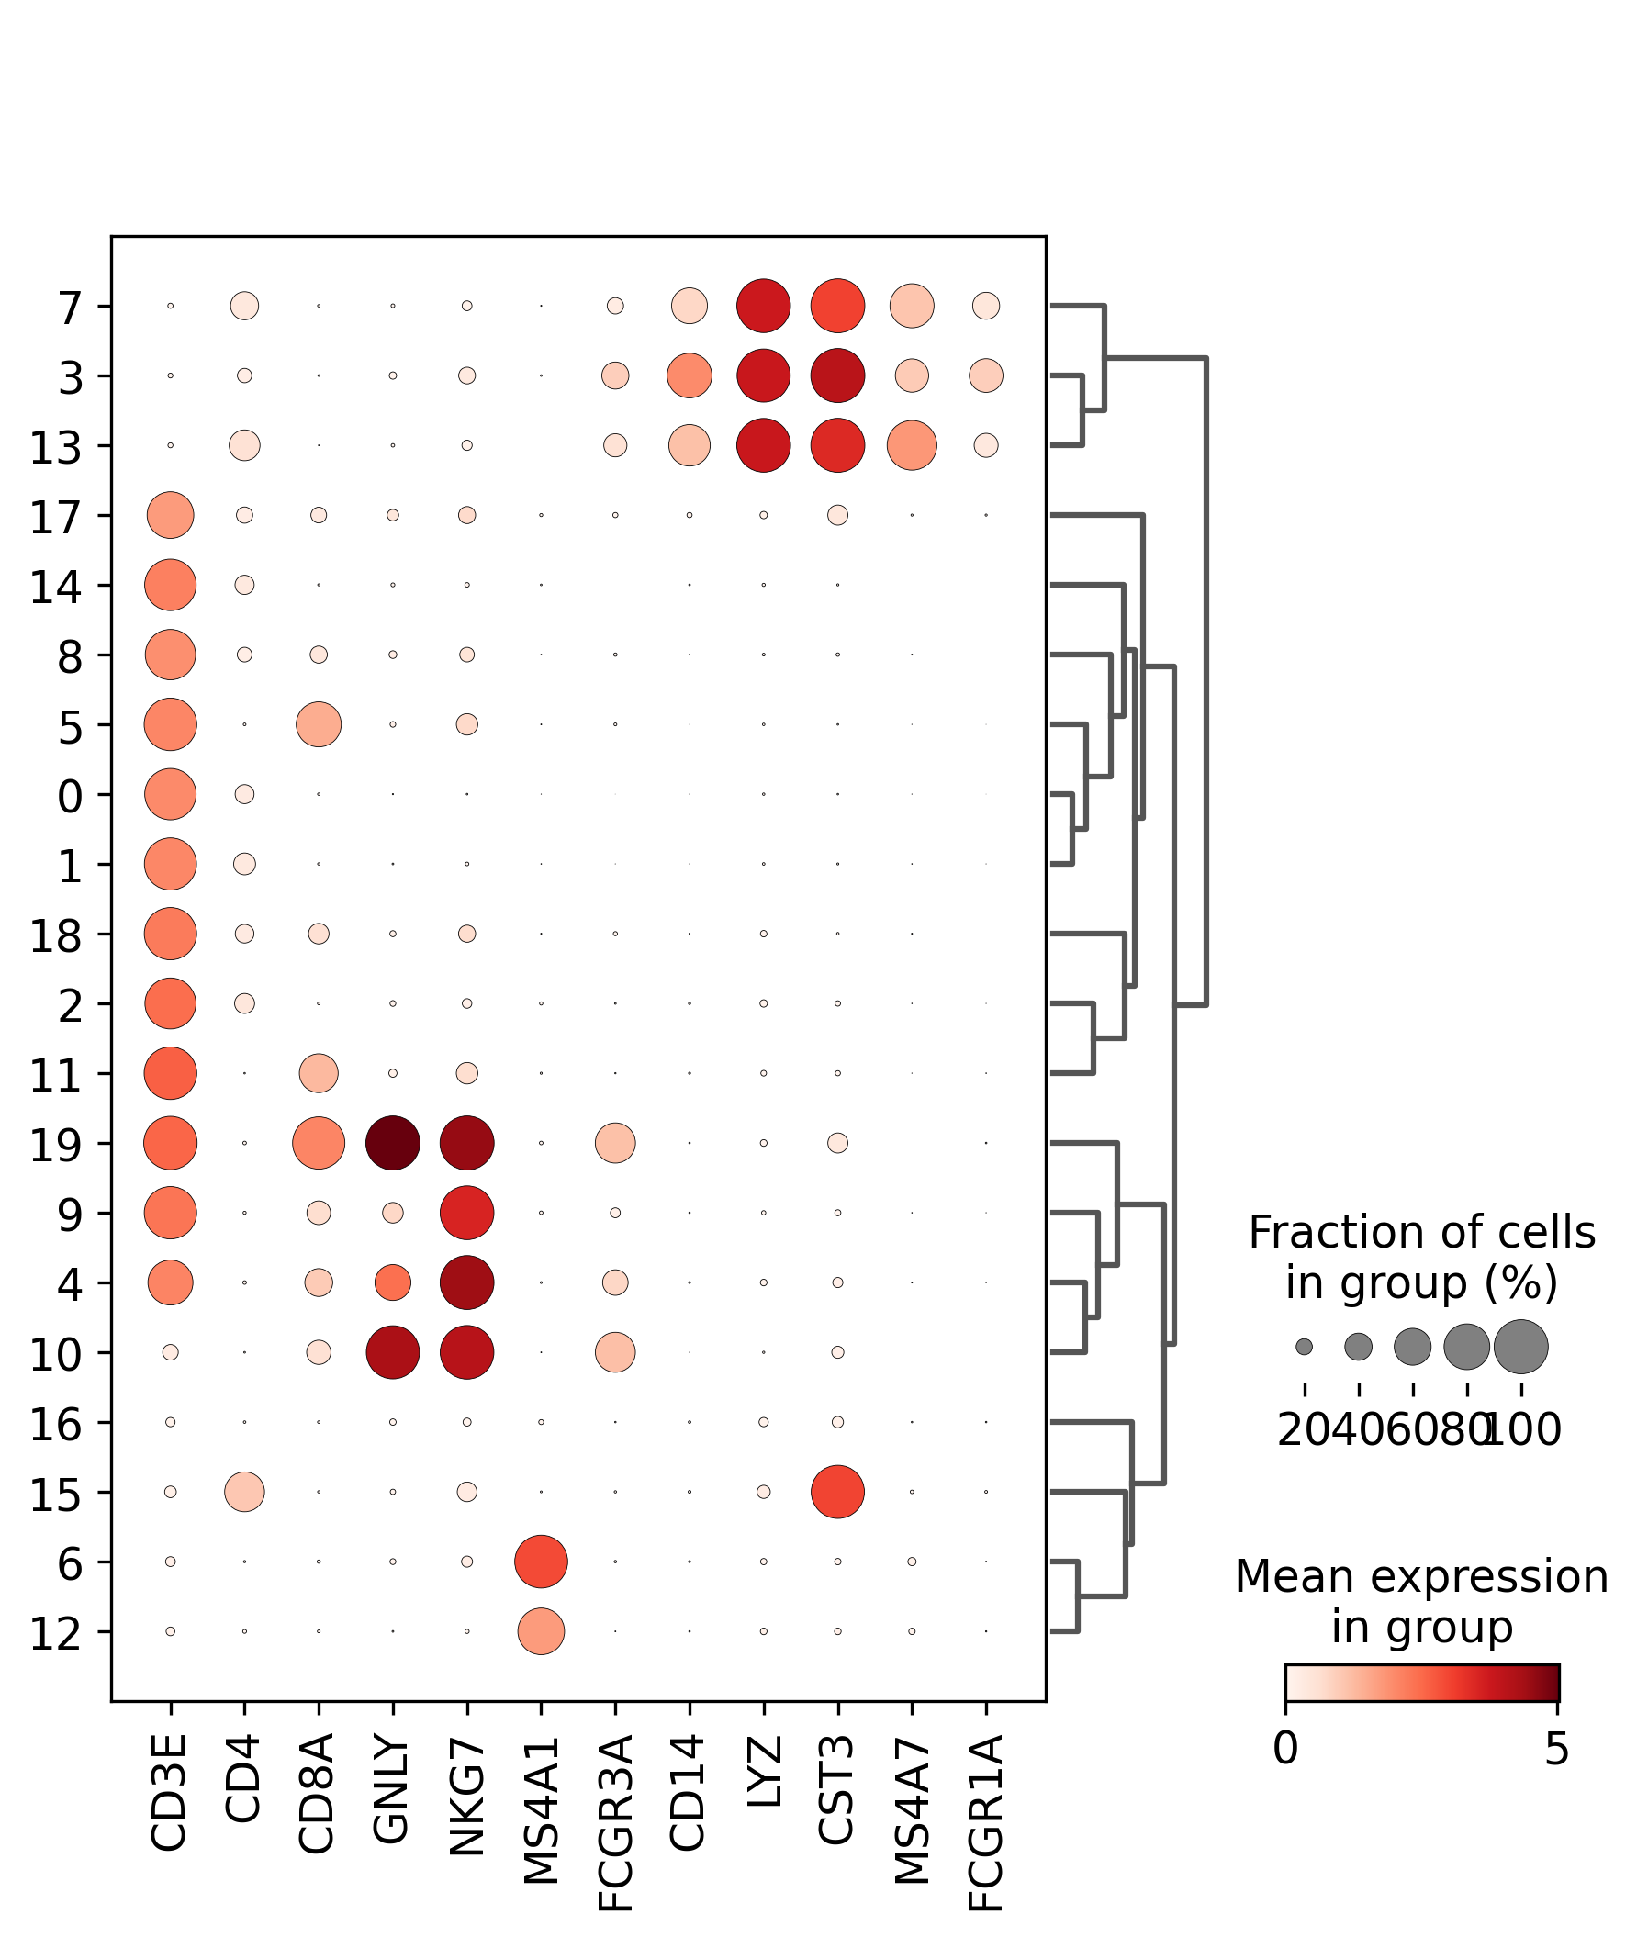
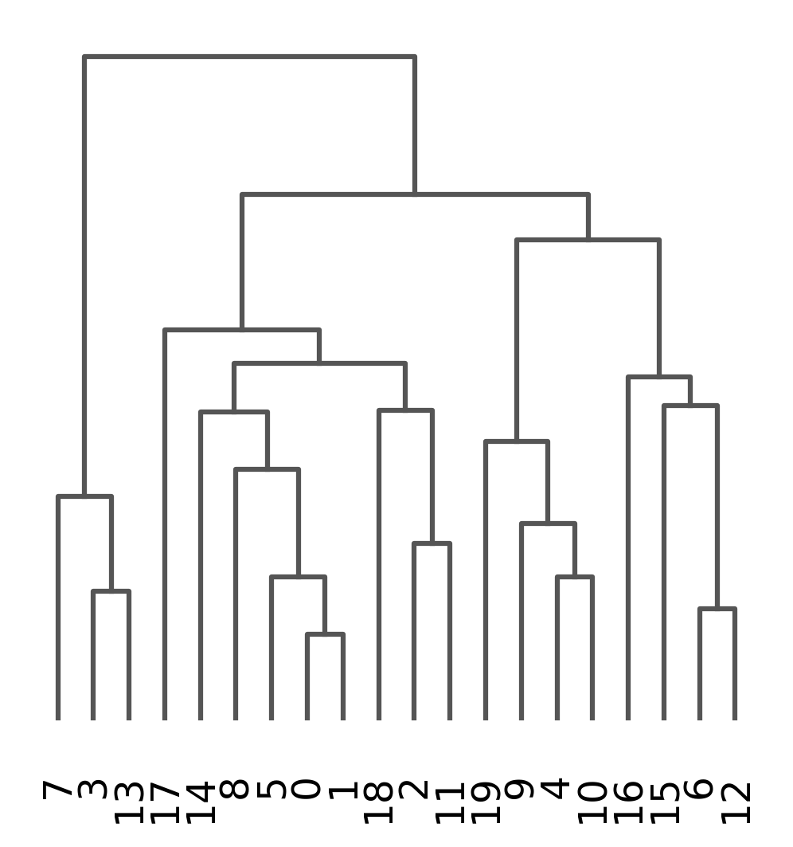
Different value different cluster size

Slide 15
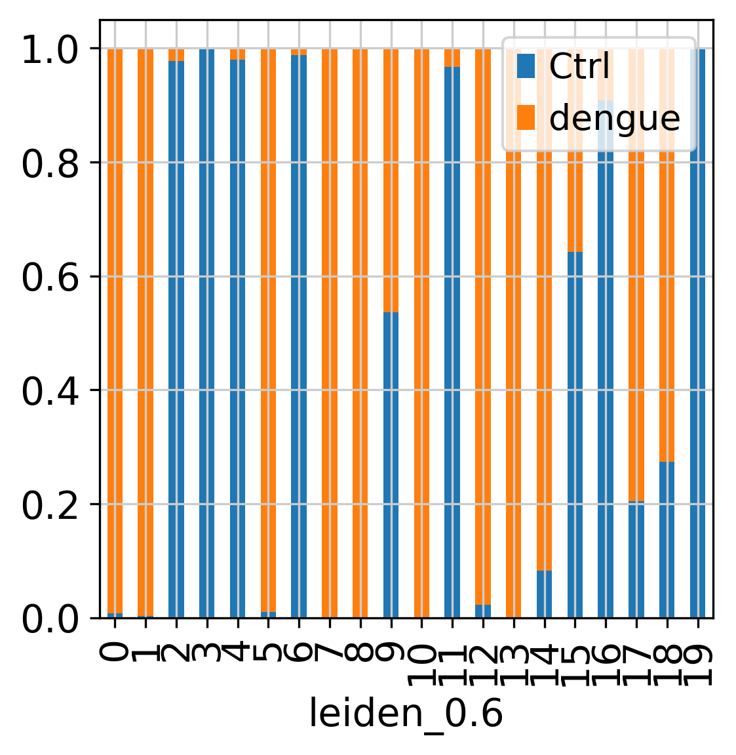
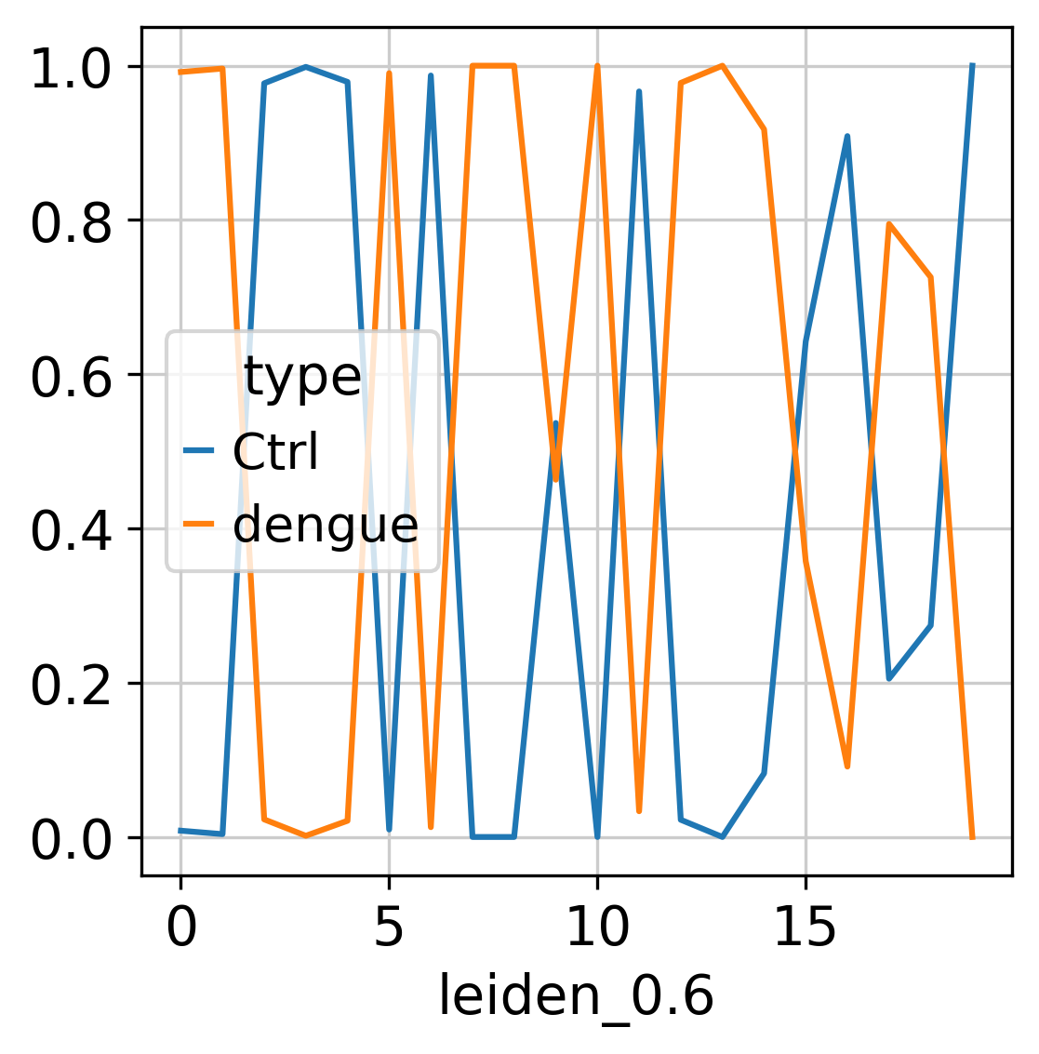
Better differentiation in leiden_0.6

Slide 16
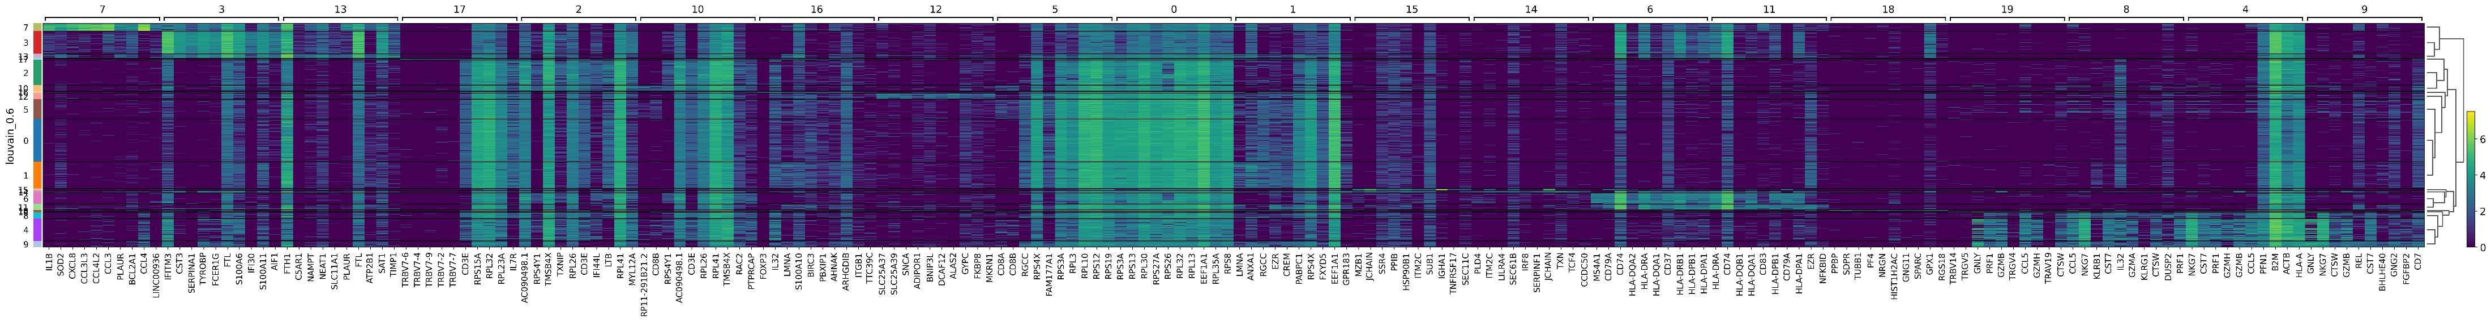
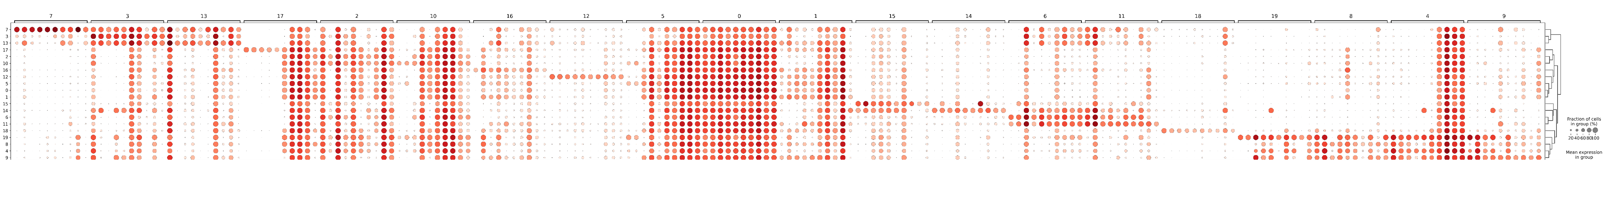
Top 10 expression in each cluster

Slide 17
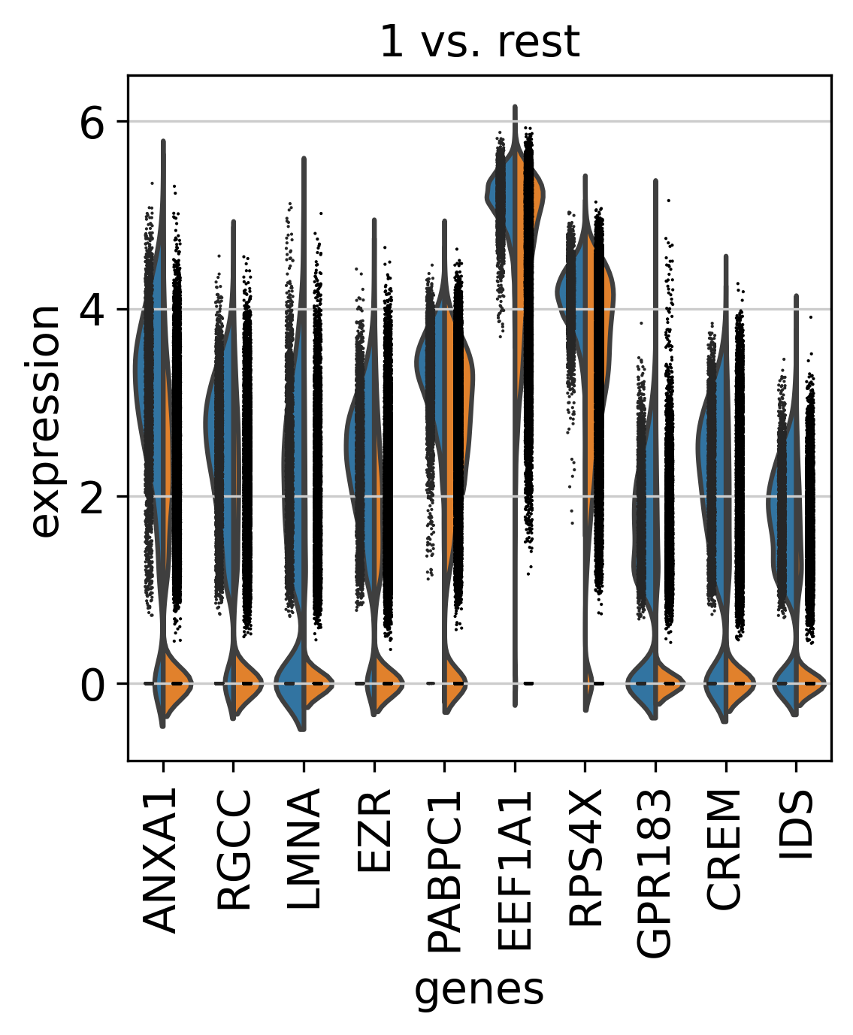
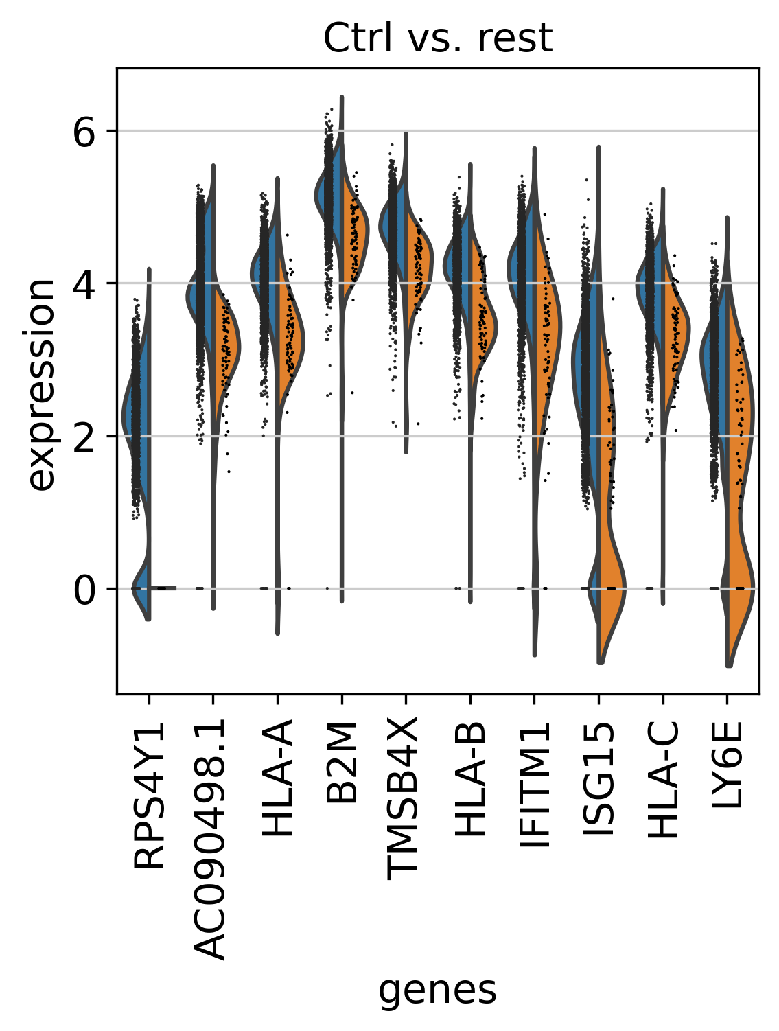
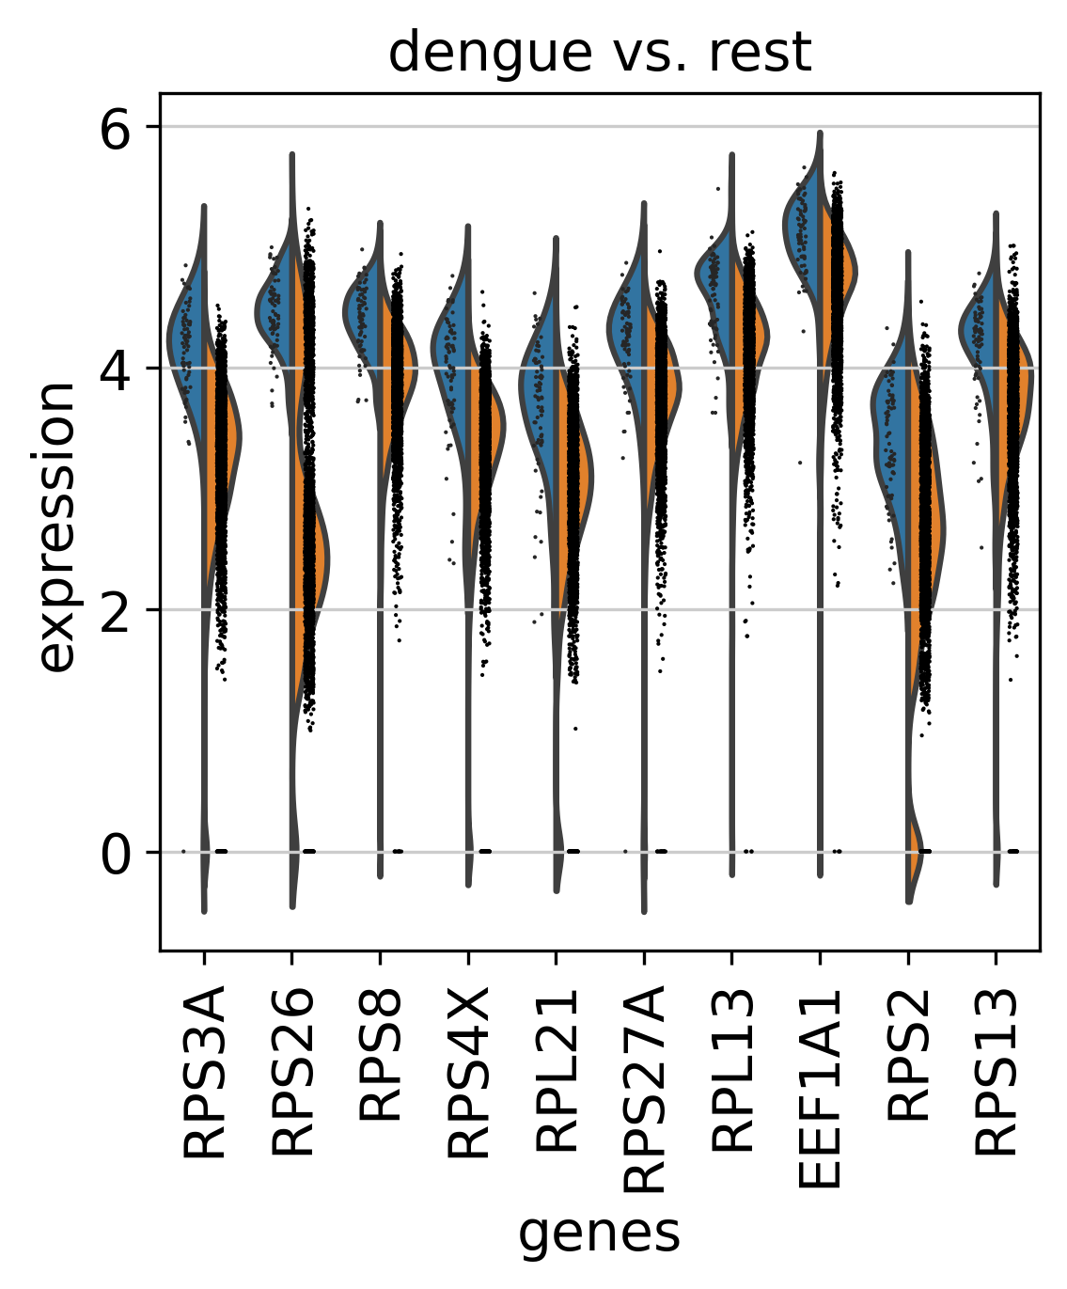
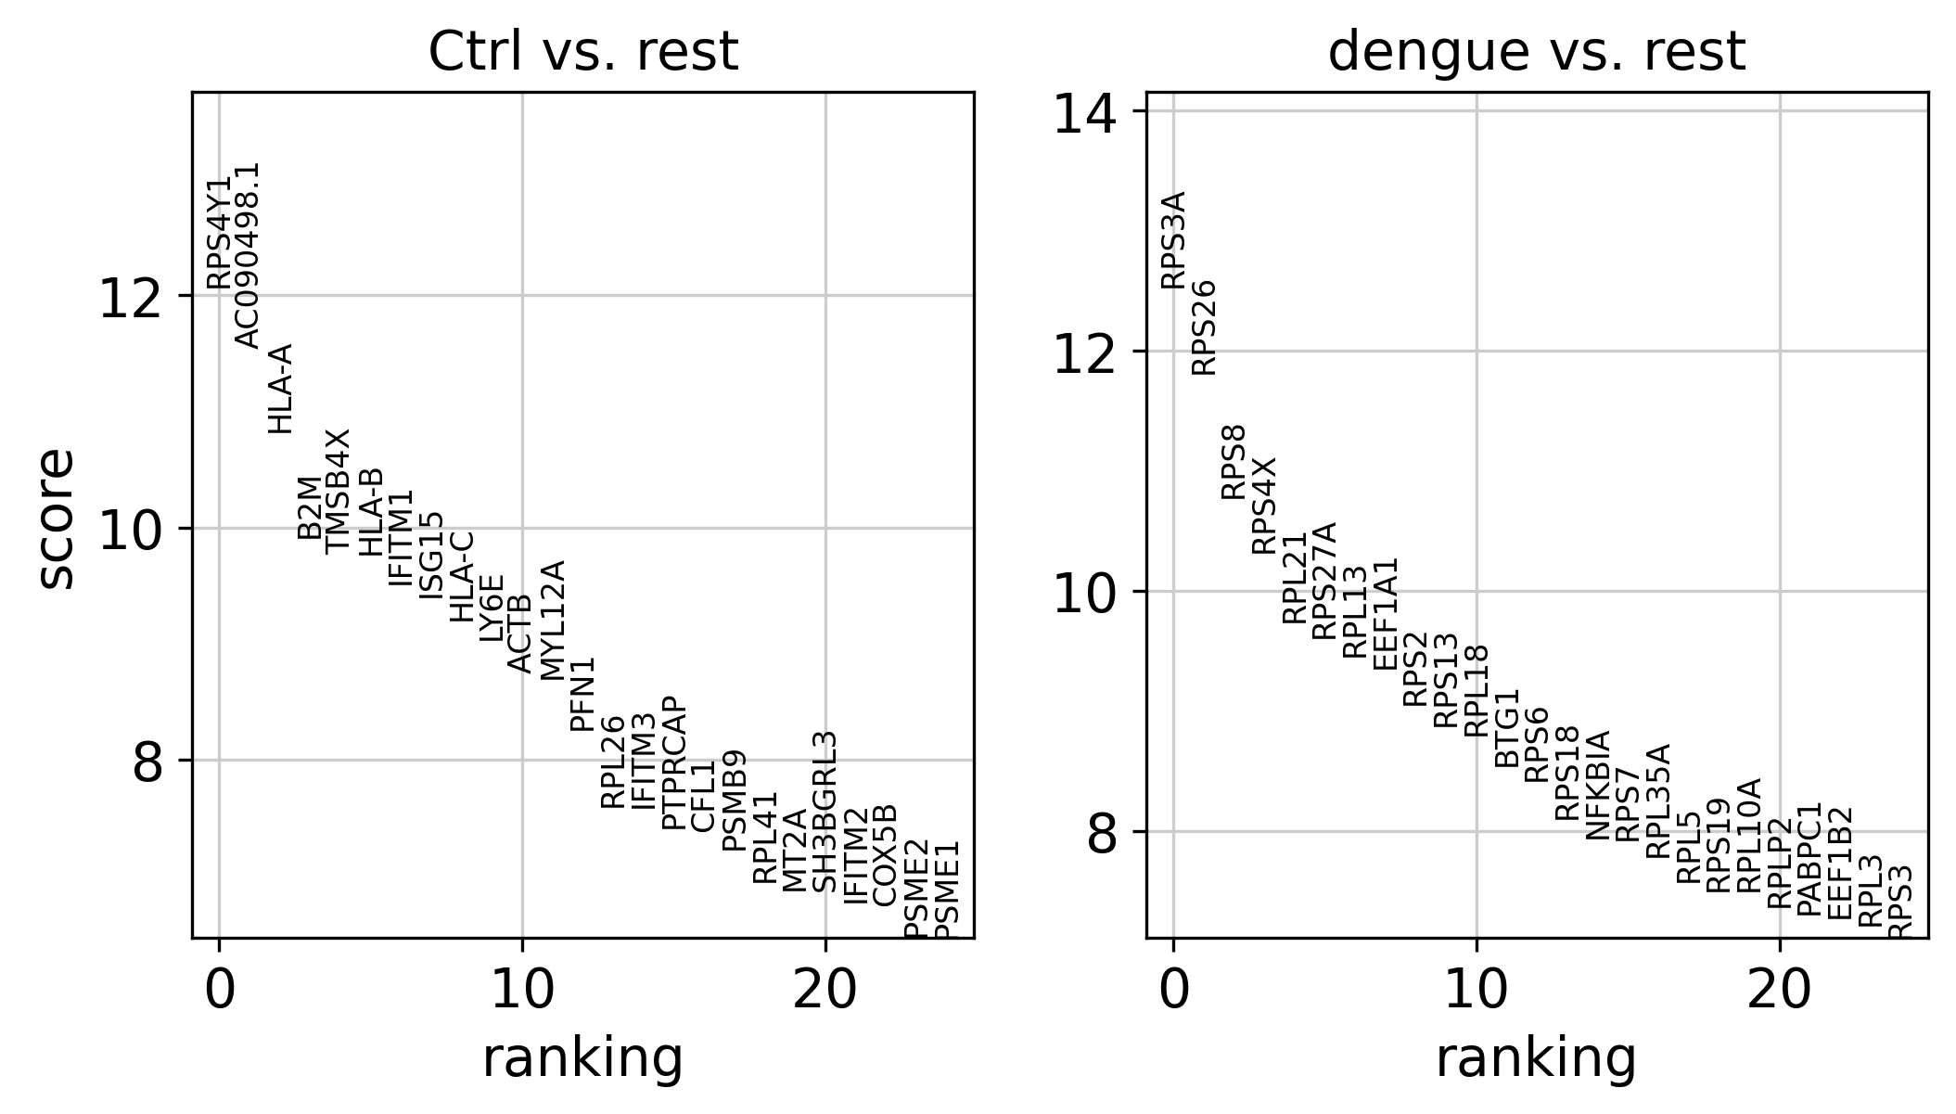
Cluster specific genes expression
Sample specific gene expression

Slide 18
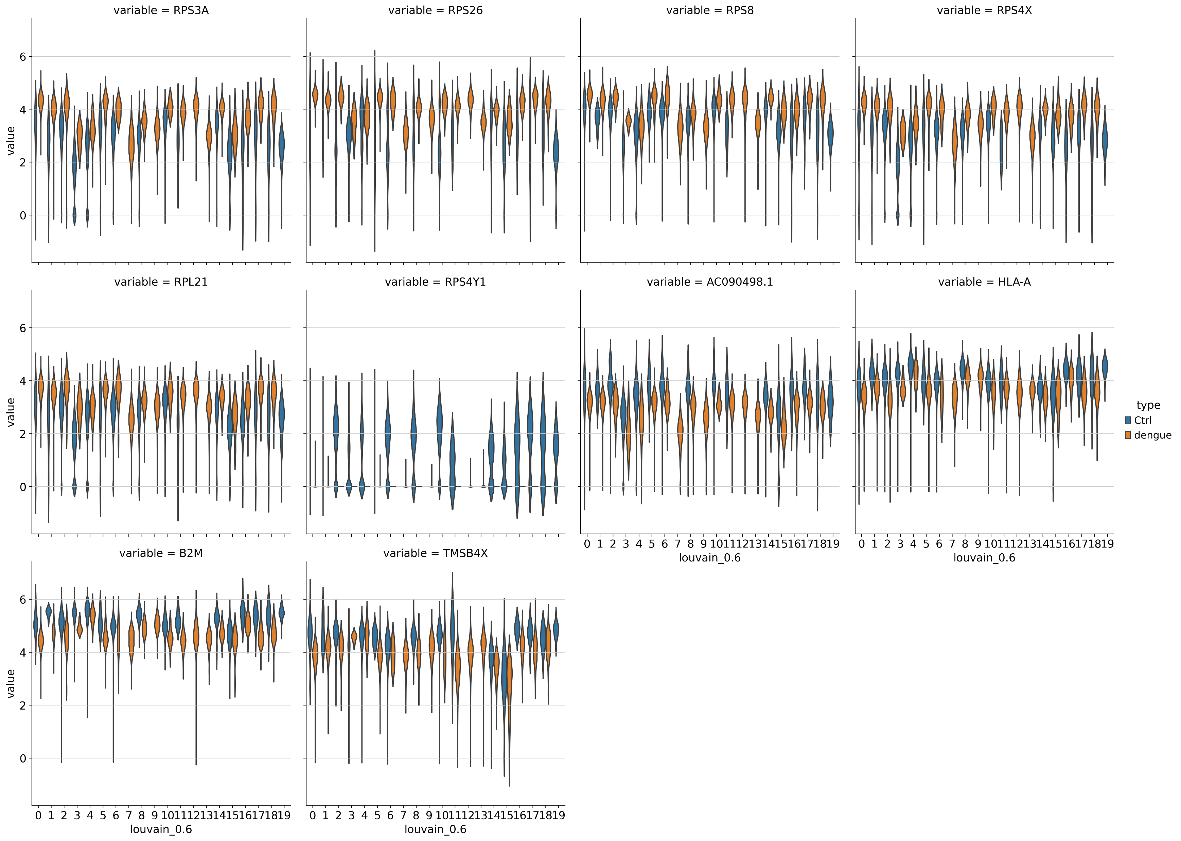
Ctrl vs Dengue gene expression

Slide 19
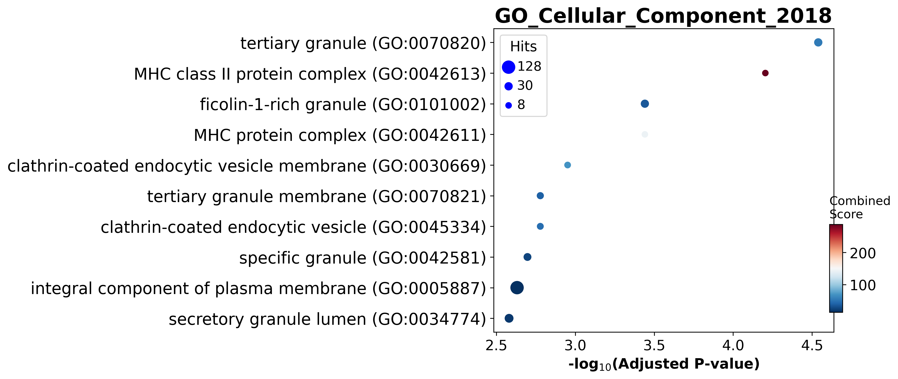
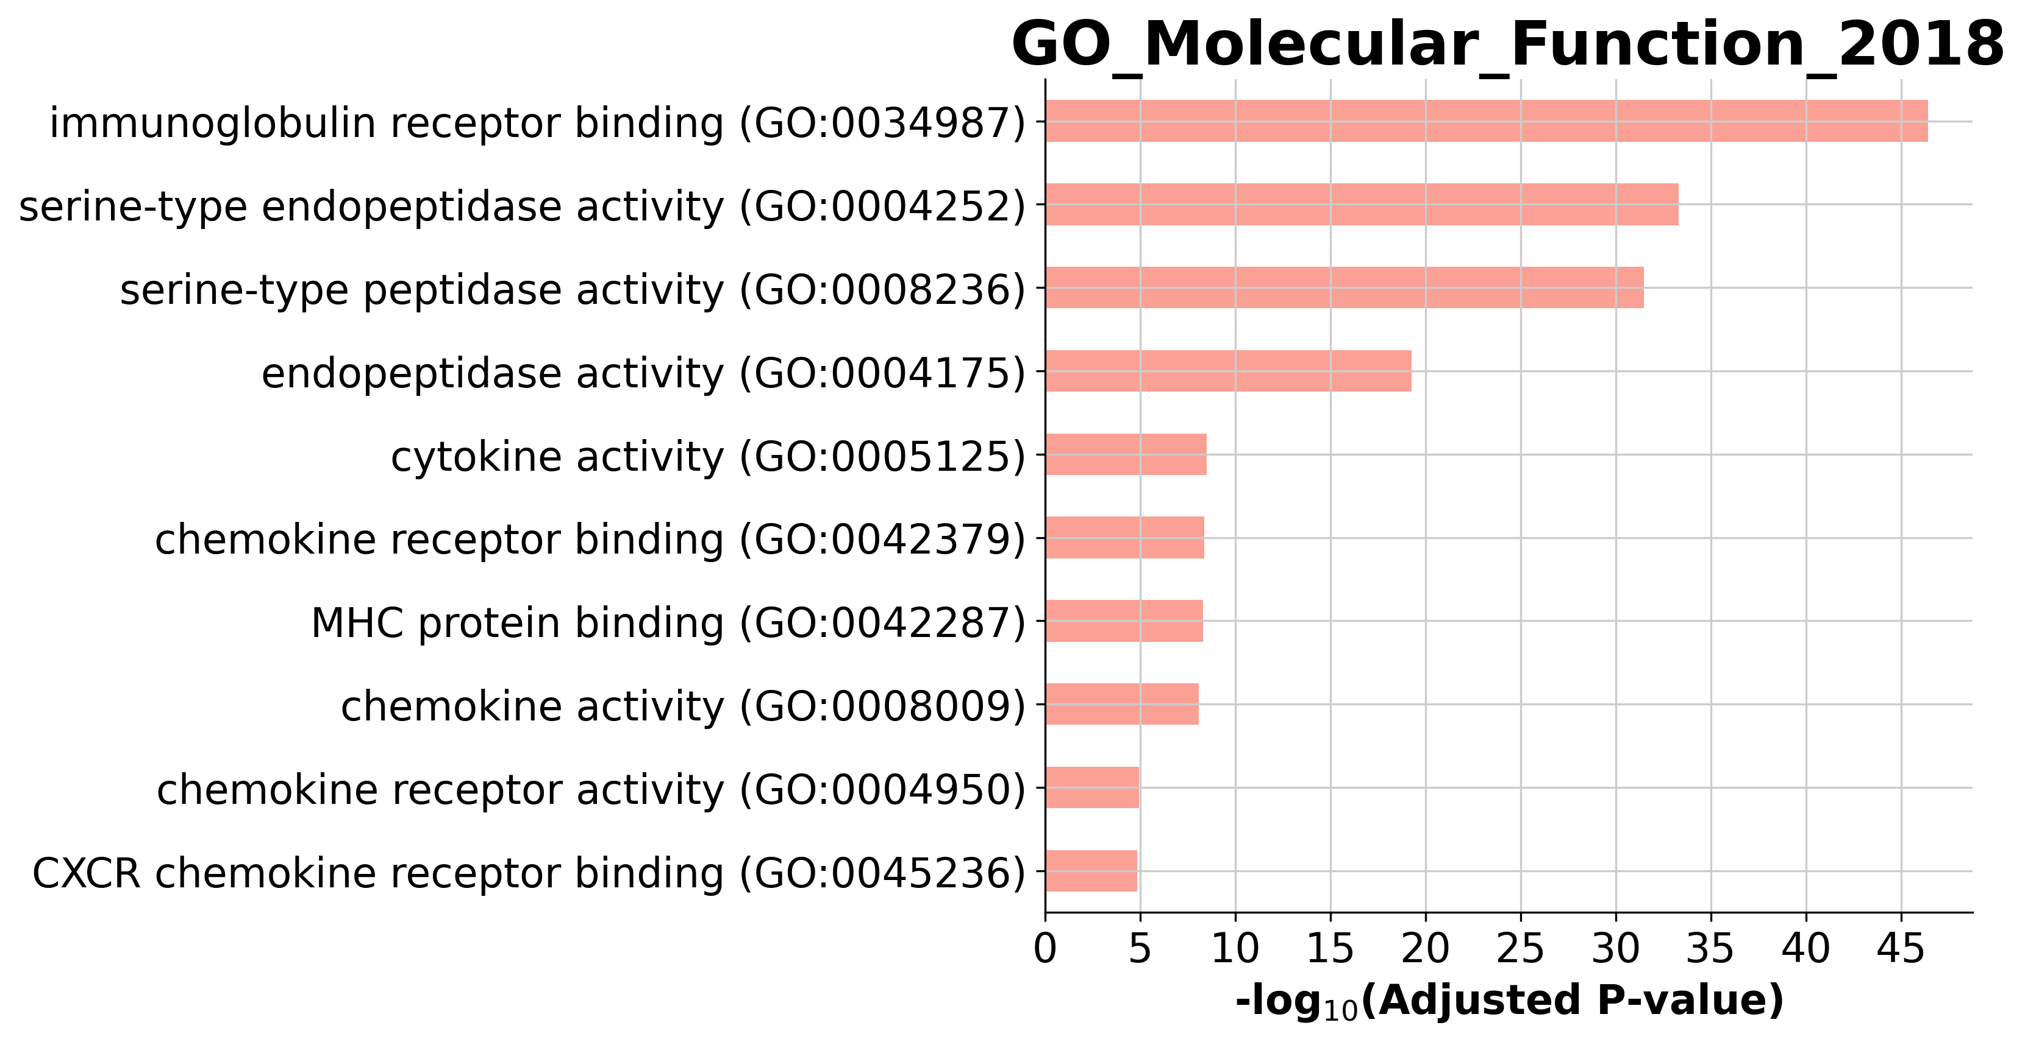
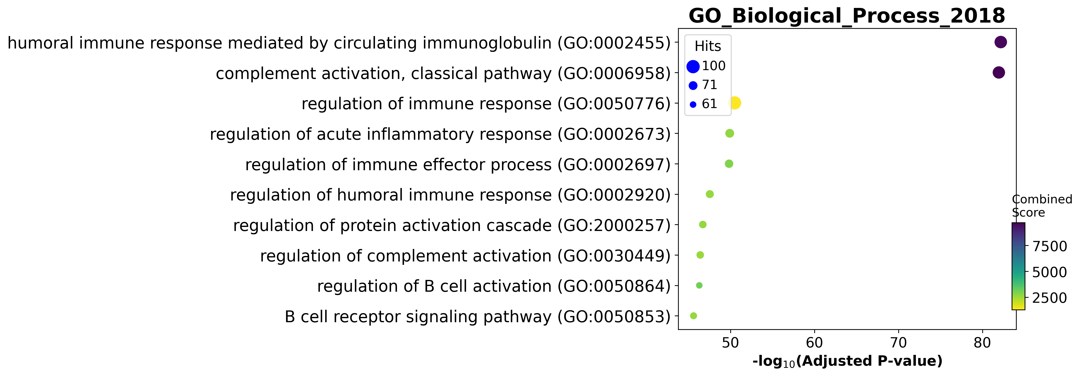
GSEA

Slide 20
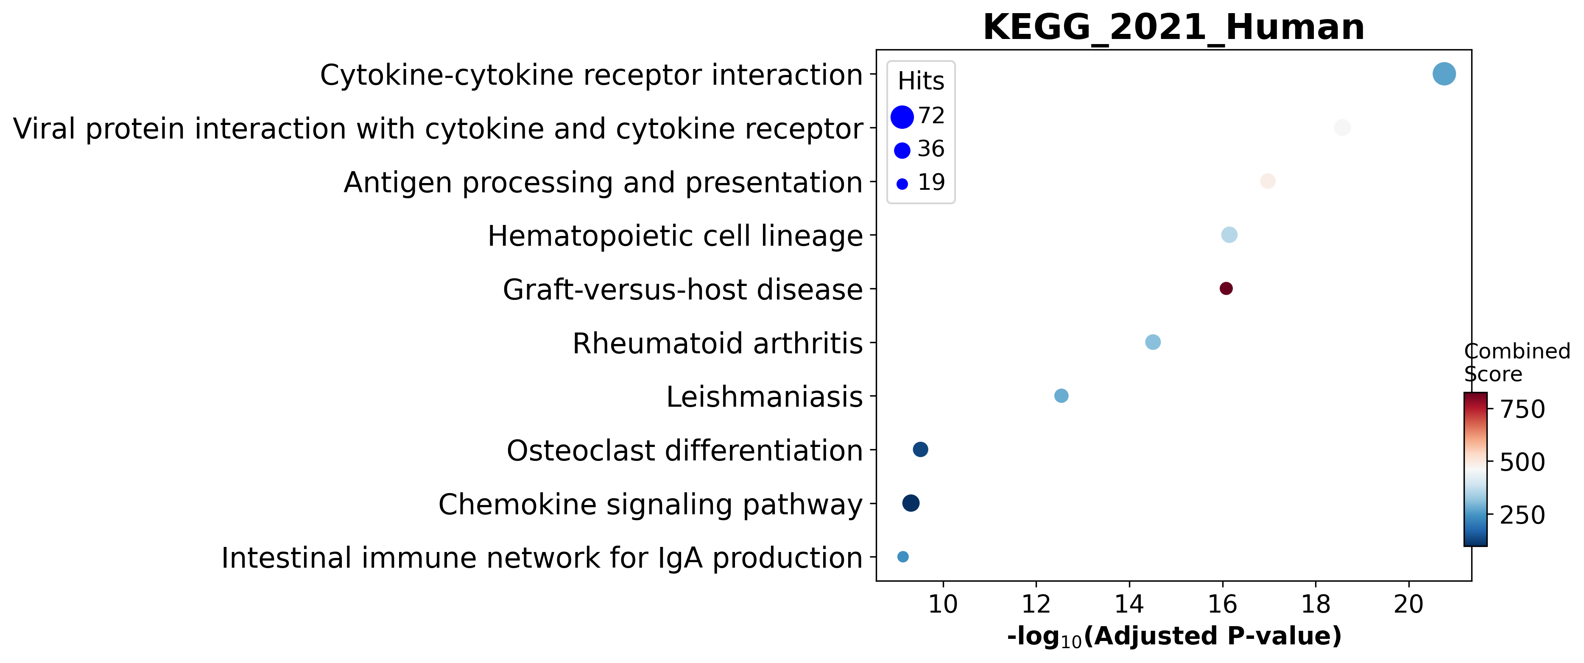
Pathways of highly expressed genes

Slide 21
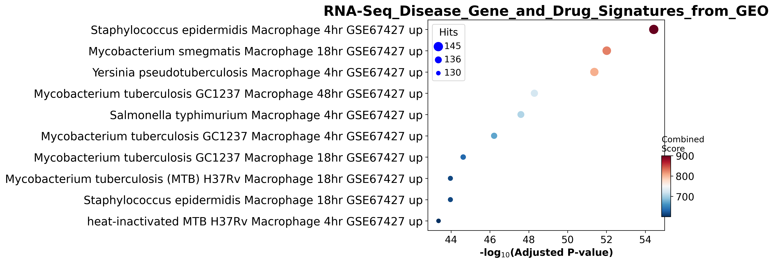
Disease Signature
viruses, and bacteria regulate host cell IL-10 expression to allow persistent infection.
positive correlation between IL-10 levels and dengue disease severity.
https://doi.org/10.1186/1423-0127-20-40

Slide 22
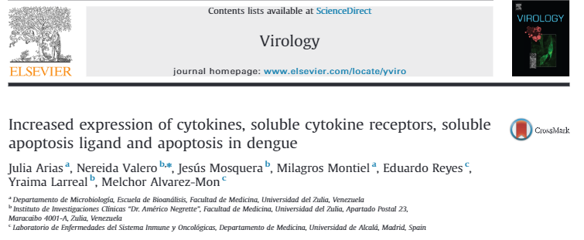
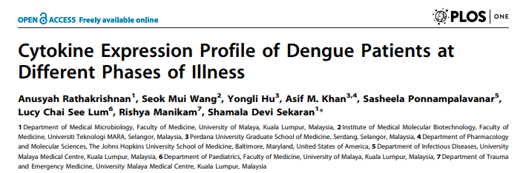
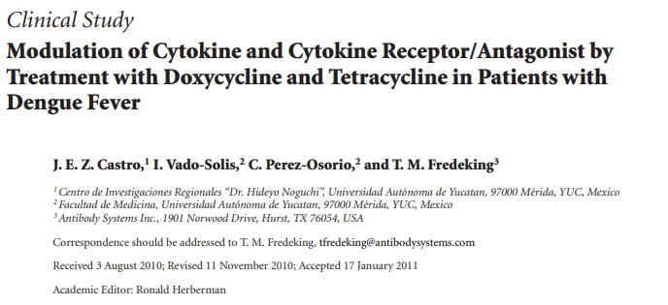
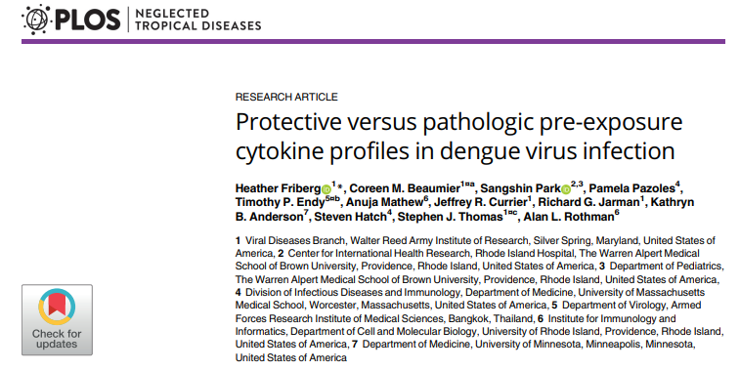
Abstract
Significant differences were found in cytokine production based on both the type of DENV used for stimulation and the occurrence of clinical illness
Secretion of IL-15 and MCP-1 was significantly higher by PBMC of subjects who later developed symptomatic DENV infection.
These biomarkers can be present in dengue regardless the disease severity.
All dengue positive have the marker genes highly expressed.

Slide 23

Thank You
Visit Github
No dataset [ github restriction 100MB]
chemoinfolab.online
SCANPY folder Complete files available
(need signup, only name and pwd)

Slide 26
Aryl hydrocarbon receptor Netpath (Homo sapiens)
The Aryl Hydrocarbon receptor (AhR) is ligand activated transcription factor that regulates wide spectrum of gene expression.
The main mediator of AhR is 2,3,7,8-Tetrachlorodibenzo-p-dioxin (TCDD) or polycyclic aromatic hydrocarbons which are widespread environmental pollutant causing a variety of severe health effects, e.g.immunosuppression, carcinogenesis and hepatotoxicity

Slide 27
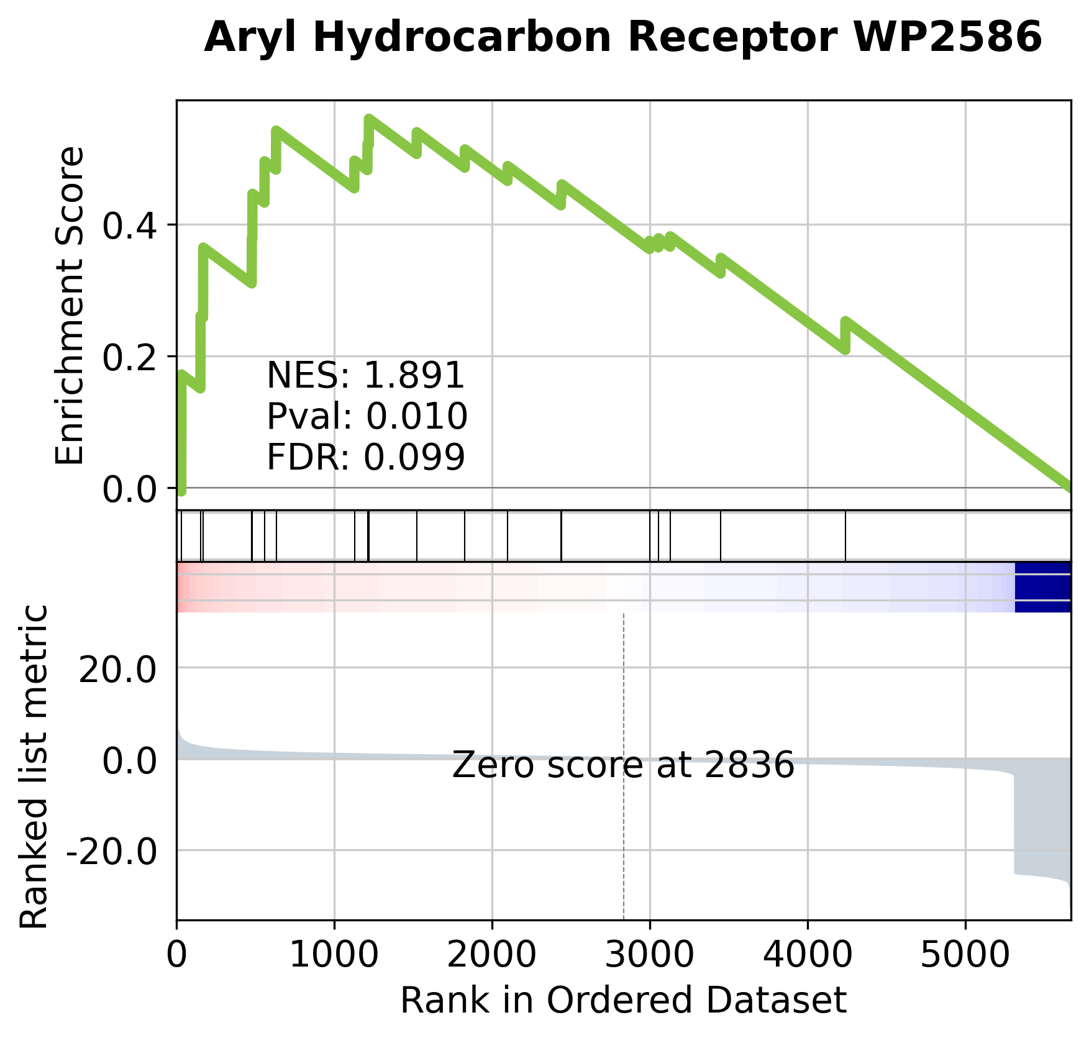
WikiPathways2019
Index(['Aryl Hydrocarbon Receptor WP2586', 'Alzheimers Disease WP2059', 'Photodynamic therapy-induced NF-kB survival signaling WP3617', 'Neural Crest Differentiation WP2064', 'Bladder Cancer WP2828', 'Sudden Infant Death Syndrome (SIDS) Susceptibility Pathways WP706', 'miRNA regulation of prostate cancer signaling pathways WP3981', 'Wnt Signaling Pathway and Pluripotency WP399', 'Parkin-Ubiquitin Proteasomal System pathway WP2359', 'Oxidative Damage WP3941', 'Aryl Hydrocarbon Receptor Pathway WP2873', 'Non-genomic actions of 1,25 dihydroxyvitamin D3 WP4341', 'White fat cell differentiation WP4149', 'Interferon type I signaling pathways WP585', 'Angiopoietin Like Protein 8 Regulatory Pathway WP3915', 'IL-7 Signaling Pathway WP205', 'Fas Ligand (FasL) pathway and Stress induction of Heat Shock Proteins (HSP) regulation WP314', 'Translation Factors WP107', 'Regulation of Microtubule Cytoskeleton WP2038', 'Hematopoietic Stem Cell Differentiation WP2849'], dtype='object', name='Term')

